Slide 1

Azure Monitor Overview & Demos
ARTURO QUIROGA – Sr. Partner Solutions Architect
Azure AI services specialist
Microsoft Americas
Notes:
This is an E2E deck. Yet, you can select slides and spent time on most relevant topics identified with your customer. If you chose Scenario A, take a couple of minutes to remind customer Azure Monitor value proposition (the why).
Scenario A (L300): Customer is already aware about Azure Monitor value proposition and wants to deep dive on how Azure Monitor works and its capabilities
Audience: TDM + Directs, System Engineers
Use this deck and focus demo on relevant topics for your customer
Plan 1h30 workshop with the customer
Scenario B (L100 – L200 – L300): Customer is not already aware about Azure Monitor value proposition and wants to deep dive on how Azure Monitor works and its capabilities
Audience: TDM + Directs, System Engineers
Start with ‘Azure Monitor overview and slide library’ deck to introduce Azure Monitor value proposition and set the scene for the deep dive (plan 30 minutes)
Use this deck and focus demo on relevant topics for your customer (plan 1h30)
Plan 2h workshop in total with the customer

Slide 2
Agenda
Azure Monitor Overview
Data Sources
Data Collection & Data Collection Rules (DCRs)
Data platform
Insights
Visualization
Analysis
Response (Alerting)
Integrations

Slide 3
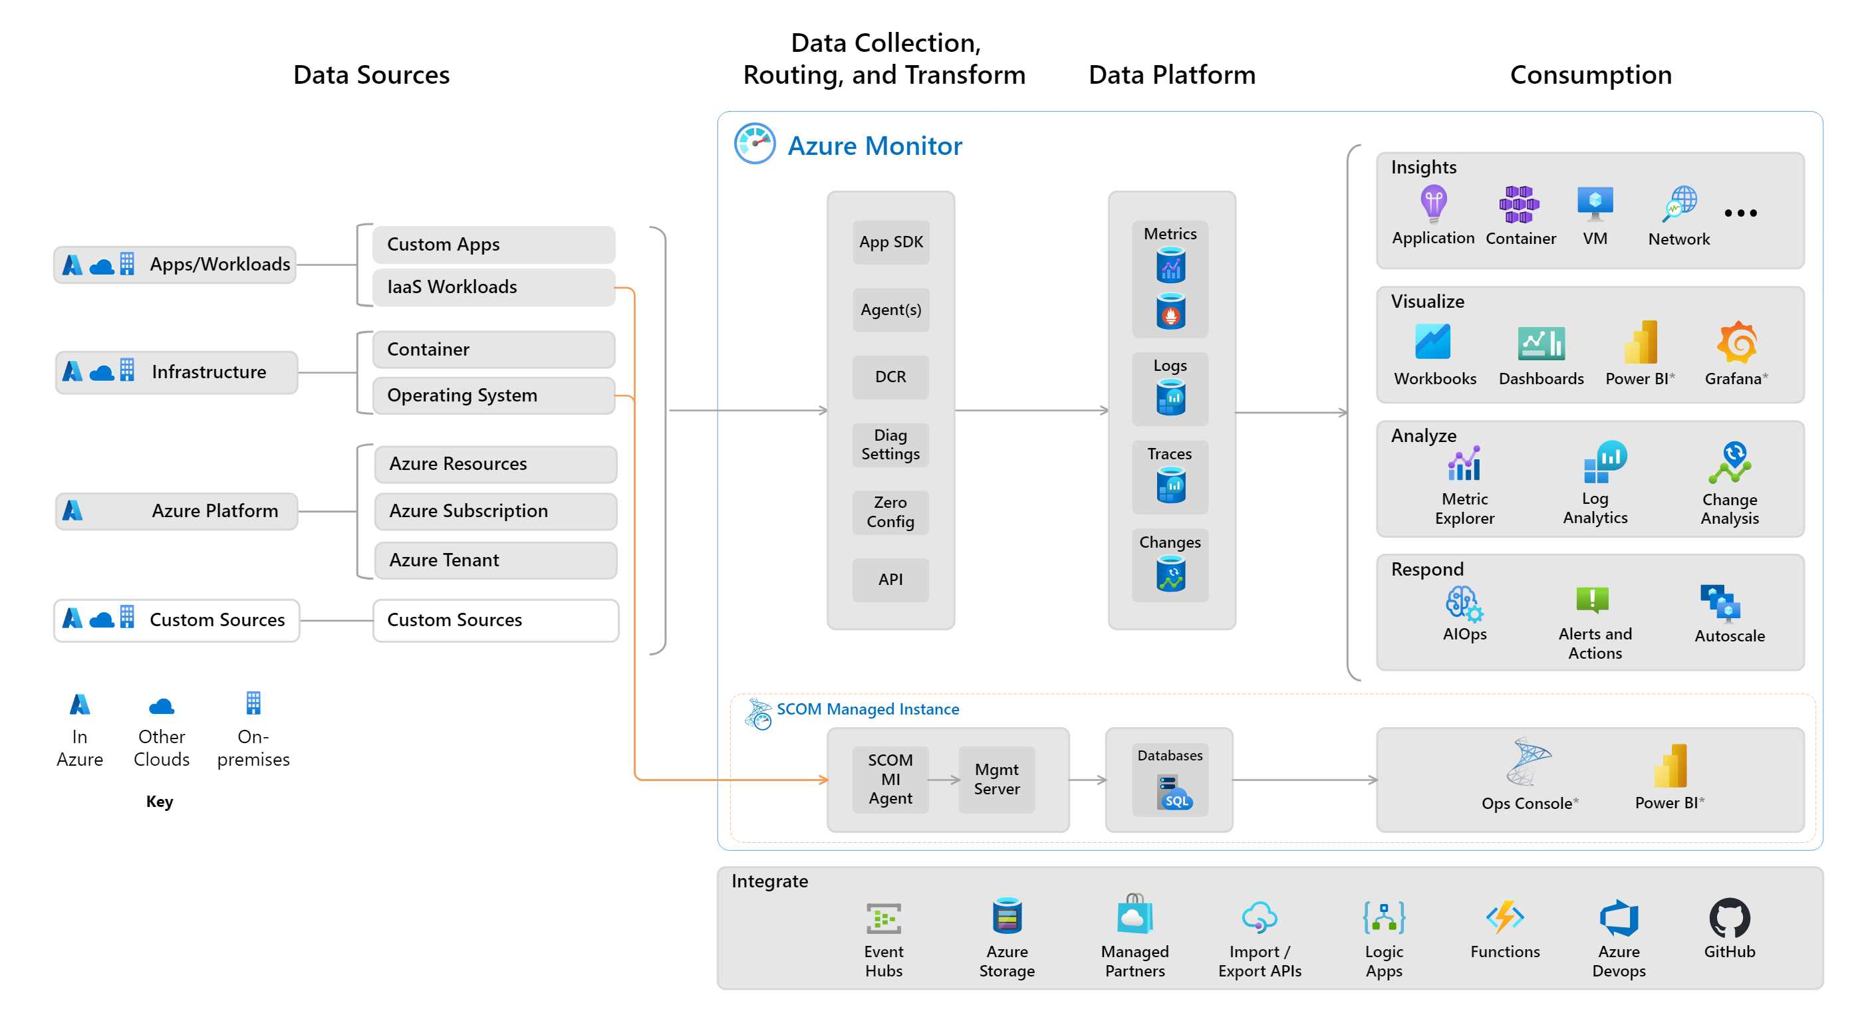
Azure Monitor overview
1
2
3
4
4.1
4.2
4.3
4.4
7
6
5
Notes:
https://learn.microsoft.com/en-us/azure/azure-monitor/overview
So how does Azure Monitor work.
It all starts with collecting telemetry. Azure Monitor can collect data from Application, Network, Infrastructure and you can also ingest your own custom data. All the data is stored in centralized, fully managed logs and metrics stores. So, what can you do with all the data:
Typically, you start with insights which are end to end experiences we have put together for canonical scenarios or resources such as applications, containers, VMs, network, storage etc. Insights provide guidance and help troubleshoot and root cause issues quickly with a drill down experience.
You may in certain cases, just want to visualize the data. For that we provide Azure dashboards, Power BI integrations and a more native experience called Workbooks.
After visualizing the data, you may form some hypothesis and want to test them out. For that you need access to the raw data stores. For that we provide metrics explorer and a powerful big data platform called Log Analytics that is capable of querying petabytes of data within seconds.
If you want to pro-active and take corrective actions, you can create alerts and runbooks to auto remedy an issue. Or if it’s a capacity issue, you can choose to scale-in or scale-out
Finally, we know that monitoring isn’t done is silos. Azure Monitor provides out of the box integration with popular ITSM and DevOps tools. You can again use APIs, EventHub and Logic Apps to build custom integrations.

Slide 4
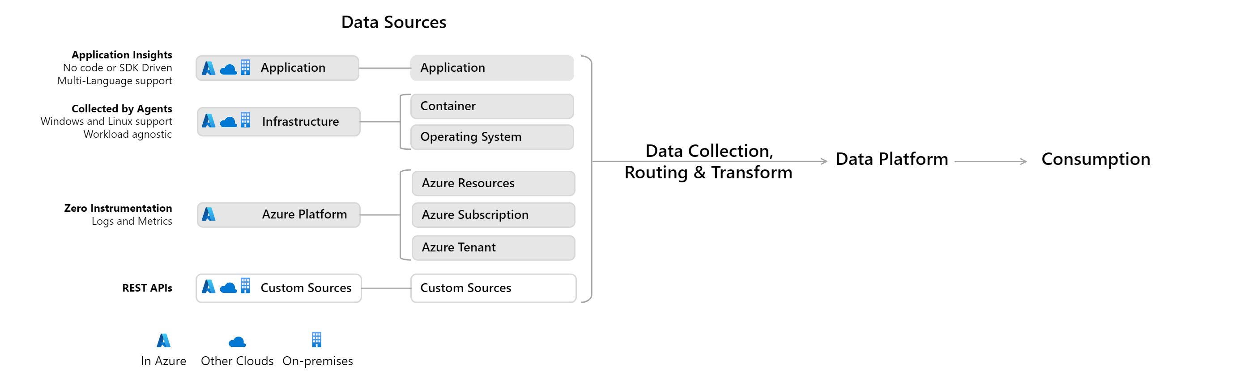
Sources of monitoring data for Azure Monitor
1
Notes:
https://learn.microsoft.com/en-us/azure/azure-monitor/data-sources
https://learn.microsoft.com/en-us/azure/azure-monitor/overview#data-sources
The diagram shows an expanded version of the datasource types gathered by Azure Monitor. You can integrate application, infrastructure, and custom data source monitoring data from outside Azure, including from on-premises, and non-Microsoft clouds.
Azure Monitor collects these types of data:
App/Workloads
App- Application performance, health, and activity data. Detailed application monitoring in Azure Monitor is done with Application Insights, which collects data from applications running on various platforms. The application can be running in Azure, another cloud, or on-premises.
Workloads - IaaS workloads such as SQL server, Oracle or SAP running on a hosted Virtual Machine.
Infrastructure
Container - Data about containers, such as Azure Kubernetes Service, Prometheus, and the applications running inside containers.
Operating system - Data about the guest operating system on which your application is running. Compute resources in Azure, in other clouds, and on-premises have a guest operating system to monitor. With the installation of Azure Monitor Agent, you can gather telemetry from the guest into Azure Monitor to analyze it with the same monitoring tools as the Azure services themselves.
Azure Platform
Azure resource - Data about the operation of an Azure resource from inside the resource, including changes. Platform Metrics and Resource Logs provide information about the internal operation of Azure resources. These are available for most Azure services, and monitoring solutions and insights collect additional data for particular services.
Azure subscription - The operation and management of an Azure subscription, and data about the health and operation of Azure itself. Activity Logs and Service Health.
Azure tenant - Data about the operation of tenant-level Azure services, such as Azure Active Directory. Azure Active Directory Audit Logs and Azure Active Directory reporting contains the history of sign-in activity and audit trail of changes made within a particular tenant.
Custom Sources
Data which gets into the system using the - Azure Monitor REST API - Data Collection API

Slide 5
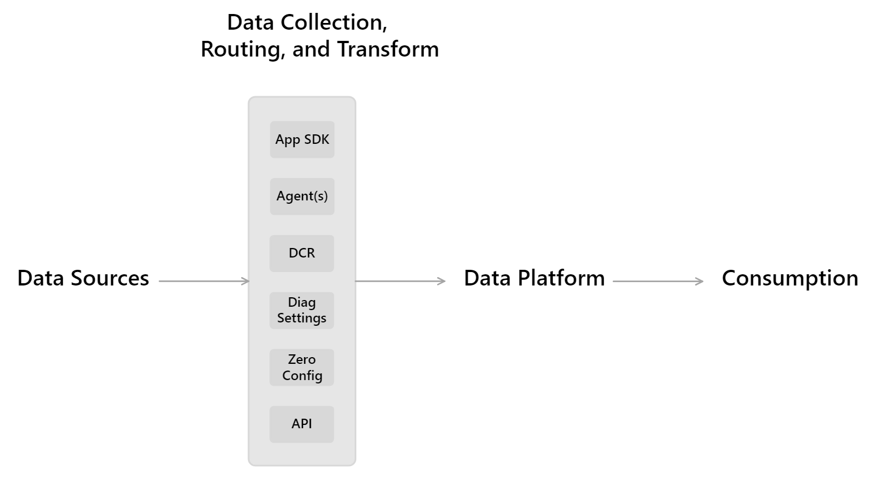
Data collection in Azure Monitor
2
Notes:
https://learn.microsoft.com/en-us/azure/azure-monitor/overview#data-collection-and-routing
https://learn.microsoft.com/en-us/azure/azure-monitor/essentials/data-collection
Application instrumentation: Application Insights is enabled through either Auto-Instrumentation (agent) or by adding the Application Insights SDK to your application code. In addition, Application Insights is in process of implementing Open Telemetry. For more information, reference How do I instrument an application?.
Agents: Agents can collect monitoring data from the guest operating system of Azure and hybrid virtual machines.
Data collection rules: Use data collection rules to specify what data should be collected, how to transform it, and where to send it.
Zero Config: Data is automatically sent to a destination without user configuration. Platform metrics are the most common example.
Diagnostic settings: Use diagnostic settings to determine where to send resource log and activity log data on the data platform.
Azure Monitor REST API: The Logs Ingestion API in Azure Monitor lets you send data to a Log Analytics workspace in Azure Monitor Logs. You can also send metrics into the Azure Monitor Metrics store using the custom metrics API.
Azure Monitor has a common data platform that consolidates data from a variety of sources.
Azure Monitor is implementing a new ETL-like data collection pipeline that improves on legacy data collection methods. This process uses a common data ingestion pipeline for all data sources and provides a standard method of configuration, manageable and scalable.
All data collected by Azure Monitor will use the new data collection process and be managed by data collection rules.
WARNING : Implementation of new data collection process is not complete. When implementation is complete, all data collected by Azure Monitor will use the new data collection process and be managed by data collection rules. Currently, only certain data collection methods support the ingestion pipeline, and they may have limited configuration options. There's no difference between data collected with the new ingestion pipeline and data collected using other methods. The data is all stored together as Logs and Metrics, supporting Azure Monitor features such as log queries, alerts, and workbooks. The only difference is in the method of collection.

Slide 6
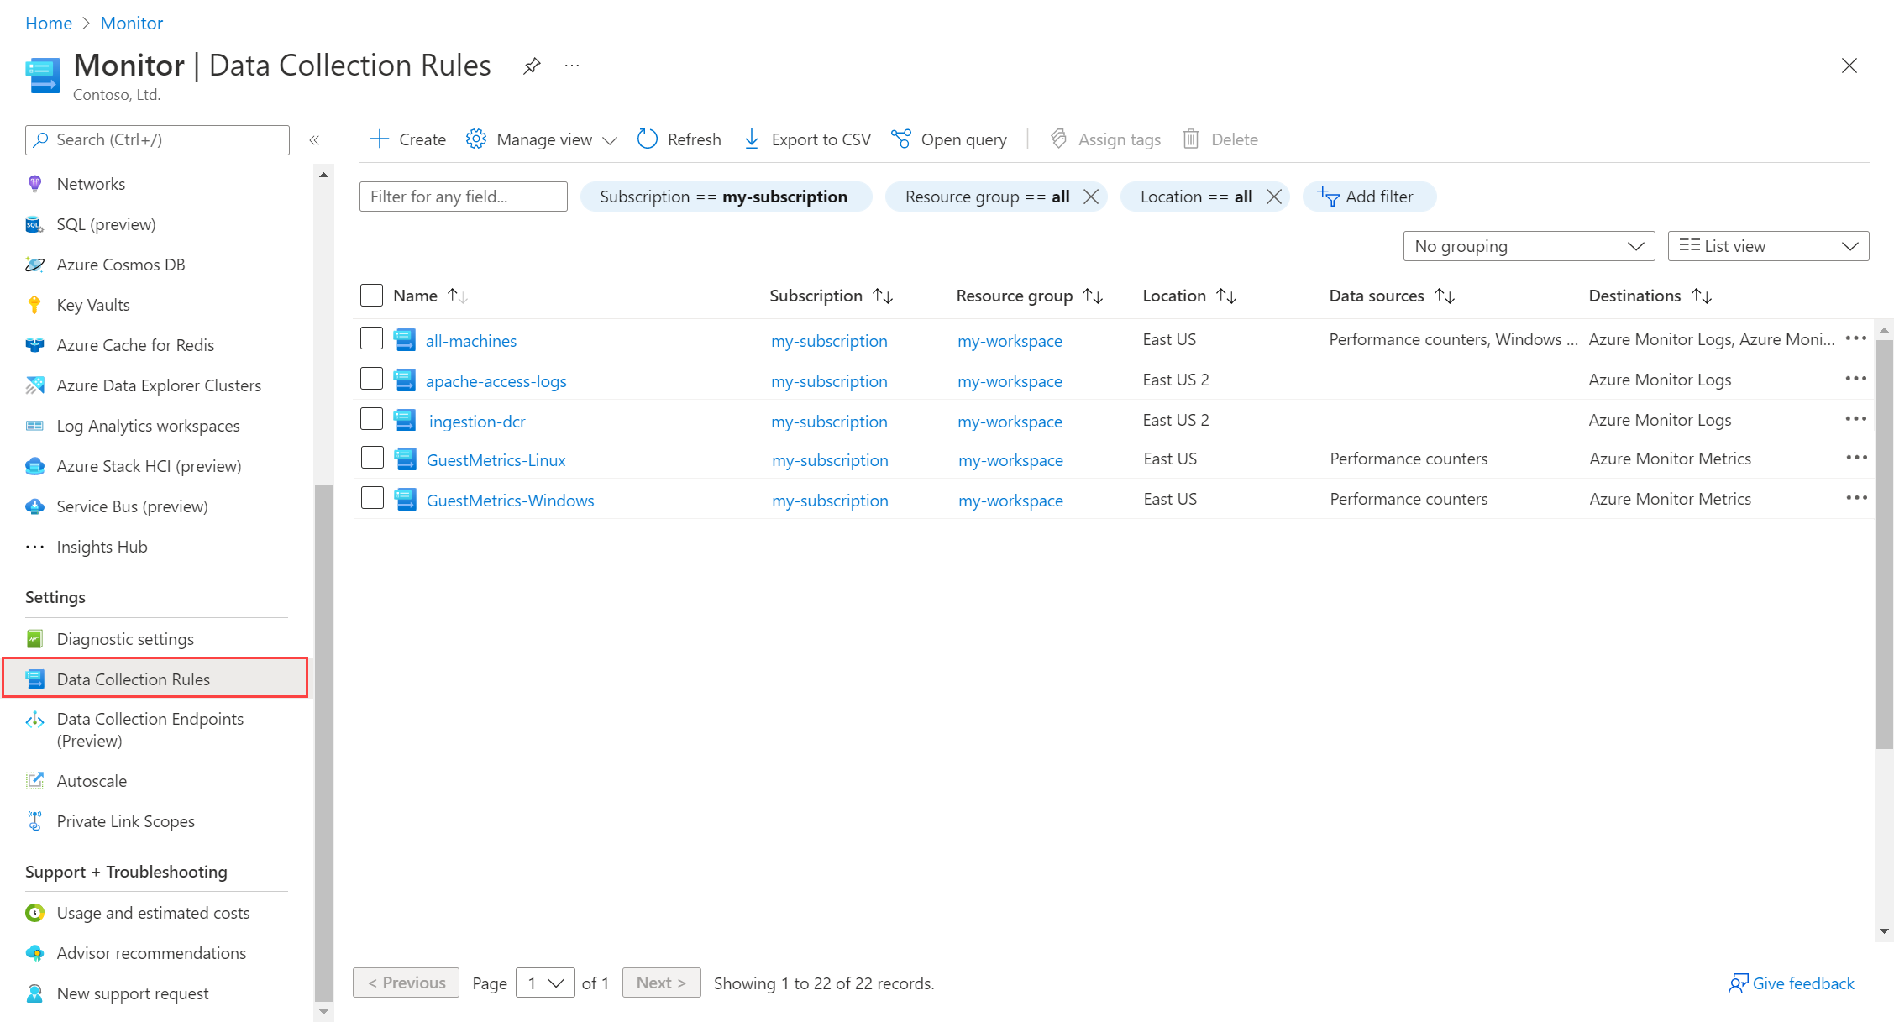

Slide 7
Data Collection Rules (DCR) with Azure Monitor Agent (AMA) - Sources
2
Performance Counters
Windows Event Logs (including sysmon events)
Linux Syslog
Custom Text Logs
Windows IIS Logs
Notes:
https://learn.microsoft.com/en-us/azure/azure-monitor/agents/data-collection-rule-azure-monitor-agent
https://learn.microsoft.com/en-us/azure/azure-monitor/agents/data-collection-syslog
https://learn.microsoft.com/en-us/azure/azure-monitor/agents/data-collection-text-log
https://learn.microsoft.com/en-us/azure/azure-monitor/agents/data-collection-iis
Performance Counters:
Basic:
Name: CPU, Memory, Disk, Network, System, Process
Sample rate (seconds): Between 1 and 300
Custom: See portal
Windows Event Logs:
Application: Critical, Error, Warning, Information, Verbose
Security: Audit success, Audit failure
System: Critical, Error, Warning, Information, Verbose
Custom: XPath queries
Linux Syslog:
Facility: LOG_AUTH, LOG_DEBUG, LOG_AUTHPRIV, LOG_DEBUG, LOG_CRON, LOG_DEBUG, LOG_DAEMON, LOG_DEBUG, LOG_MARK, LOG_DEBUG, LOG_KERN, LOG_DEBUG, LOG_LOCAL0, LOG_DEBUG, LOG_LOCAL1, LOG_DEBUG, LOG_LOCAL2, LOG_DEBUG, LOG_LOCAL3, LOG_DEBUG, LOG_LOCAL4, LOG_DEBUG, LOG_LOCAL5, LOG_DEBUG, LOG_LOCAL6, LOG_DEBUG, LOG_LOCAL7, LOG_DEBUG, LOG_LPR, LOG_DEBUG, LOG_MAIL, LOG_DEBUG, LOG_NEWS, LOG_DEBUG, LOG_SYSLOG, LOG_DEBUG, LOG_USER, LOG_DEBUG, LOG_UUCP
Minimum log level: LOG_DEBUG, LOG_INFO, LOG_NOTICE, LOG_WARNING, LOG_ERR, LOG_CRIT, LOG_ALERT, LOG_EMERG
Custom Text Logs:
File pattern: List of comma separated file patterns for the form C:\DirectoryName\ *.log ou *.txt
Record delimiter: End-of-line for now
Transform: KQL single line query that transforms a text record into multiple columns in the Log Analytics Tables
Windows IIS Logs:
File pattern: Only change this path if the logs are not in the location configured in the IIS server, which is very rare.

Slide 8
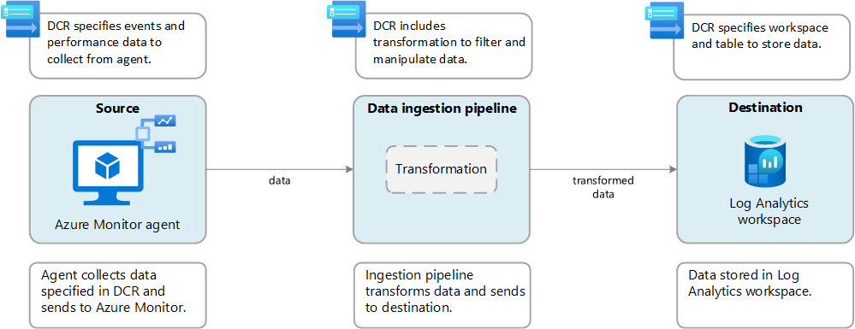
Data Collection Rules (DCR) with Azure Monitor Agent (AMA)
2
Notes:
https://learn.microsoft.com/en-us/azure/azure-monitor/essentials/data-collection
Data collection rules (DCR): Azure Monitor data collection is configured using a data collection rule (DCR). A DCR defines the details of a particular data collection scenario including what data should be collected, how to potentially transform that data, and where to send that data. A single DCR can be used with multiple monitored resources, giving you a consistent method to configure a variety of monitoring scenarios. In some cases, Azure Monitor will create and configure a DCR for you using options in the Azure portal. You may also directly edit DCRs to configure particular scenarios.
Transformations: One of the most valuable features of the new data collection process is data transformations, which allow you to apply a KQL query to incoming data to modify it before sending it to its destination. You might filter out unwanted data or modify existing data to improve your query or reporting capabilities.
The diagram shows data collection for the Azure Monitor agent running on a virtual machine. In this scenario, the DCR specifies events and performance data to collect from the agent machine, a transformation to filter and modify the data after its collected, and a Log Analytics workspace to send the transformed data. To implement this scenario, you create an association between the DCR and the agent. One agent can be associated with multiple DCRs, and one DCR can be associated with multiple agents.

Slide 9
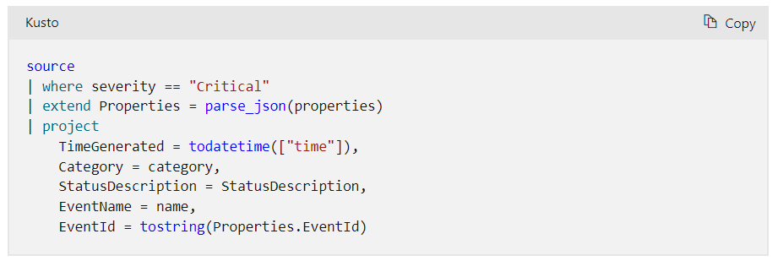
Data Collection Rules (DCR) and Transformation
2
Remove sensitive data
Enrich data with more or calculated information
Reduce data costs
Notes:
https://learn.microsoft.com/en-us/azure/azure-monitor/essentials/data-collection#transformations
https://learn.microsoft.com/en-us/azure/azure-monitor/essentials/data-collection-transformations
Transformations: One of the most valuable features of the new data collection process is data transformations, which allow you to apply a KQL query to incoming data to modify it before sending it to its destination. You might filter out unwanted data or modify existing data to improve your query or reporting capabilities.
Why to use transformations
Remove sensitive data: You might have a data source that sends information you don't want stored for privacy or compliancy reasons.
Filter sensitive information. Filter out entire rows or particular columns that contain sensitive information.
Obfuscate sensitive information. Replace information such as digits in an IP address or telephone number with a common character.
Send to an alternate table. Send sensitive records to an alternate table with different role-based access control configuration.
Enrich data with more or calculated information
Use a transformation to add information to data that provides business context or simplifies querying the data later.
Add a column with more information. For example, you might add a column identifying whether an IP address in another column is internal or external.
Add business-specific information. For example, you might add a column indicating a company division based on location information in other columns.
Reduce data costs
Because you're charged ingestion cost for any data sent to a Log Analytics workspace, you want to filter out any data that you don't require to reduce your costs.
Remove entire rows. For example, you might have a diagnostic setting to collect resource logs from a particular resource but not require all the log entries that it generates. Create a transformation that filters out records that match a certain criteria.
Remove a column from each row. For example, your data might include columns with data that's redundant or has minimal value. Create a transformation that filters out columns that aren't required.
Parse important data from a column. You might have a table with valuable data buried in a particular column. Use a transformation to parse the valuable data into a new column and remove the original.
Send certain rows to basic logs. Send rows in your data that require basic query capabilities to basic logs tables for a lower ingestion cost.
How transformations work:
Transformations are performed in Azure Monitor in the data ingestion pipeline after the data source delivers the data and before it's sent to the destination. The data source might perform its own filtering before sending data but then rely on the transformation for further manipulation before it's sent to the destination.
Transformations are defined in a data collection rule (DCR) and use a Kusto Query Language (KQL) statement that's applied individually to each entry in the incoming data. It must understand the format of the incoming data and create output in the structure expected by the destination.
For example, a DCR that collects data from a virtual machine by using Azure Monitor Agent would specify particular data to collect from the client operating system. It could also include a transformation that would get applied to that data after it's sent to the data ingestion pipeline that further filters the data or adds a calculated column. See Creating Agent Transforms. The following diagram shows this workflow.

Slide 10
Demo Data Collection Rules (DCR) with Azure Monitor Agent (AMA)
Notes:
https://learn.microsoft.com/en-us/azure/azure-monitor/agents/data-collection-rule-azure-monitor-agent?tabs=portal
Create Data Collection Rules (DCR) through Azure Portal explaining key concepts.

Slide 11
Azure Monitor overview
1
2
3
4
4.1
4.2
4.3
4.4
7
6
5
Notes:
https://learn.microsoft.com/en-us/azure/azure-monitor/overview
So how does Azure Monitor work.
It all starts with collecting telemetry. Azure Monitor can collect data from Application, Network, Infrastructure and you can also ingest your own custom data. All the data is stored in centralized, fully managed logs and metrics stores. So, what can you do with all the data:
Typically, you start with insights which are end to end experiences we have put together for canonical scenarios or resources such as applications, containers, VMs, network, storage etc. Insights provide guidance and help troubleshoot and root cause issues quickly with a drill down experience.
You may in certain cases, just want to visualize the data. For that we provide Azure dashboards, Power BI integrations and a more native experience called Workbooks.
After visualizing the data, you may form some hypothesis and want to test them out. For that you need access to the raw data stores. For that we provide metrics explorer and a powerful big data platform called Log Analytics that is capable of querying petabytes of data within seconds.
If you want to pro-active and take corrective actions, you can create alerts and runbooks to auto remedy an issue. Or if it’s a capacity issue, you can choose to scale-in or scale-out
Finally, we know that monitoring isn’t done is silos. Azure Monitor provides out of the box integration with popular ITSM and DevOps tools. You can again use APIs, EventHub and Logic Apps to build custom integrations.

Slide 12
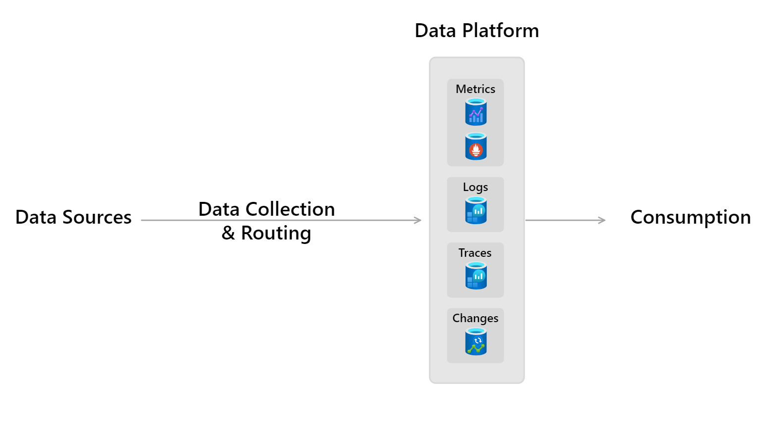
Azure Monitor data platform
3
Notes:
https://learn.microsoft.com/en-us/azure/azure-monitor/overview#data-platform
https://learn.microsoft.com/en-us/azure/azure-monitor/data-platform
Azure Monitor stores data in data stores for each of the three pillars of observability, plus an additional one:
Metrics: Azure Monitor Metrics - Metrics are numerical values that describe an aspect of a system at a particular point in time. Azure Monitor Metrics is a time-series database, optimized for analyzing time-stamped data. Azure Monitor collects metrics at regular intervals. Metrics are identified with a timestamp, a name, a value, and one or more defining labels. They can be aggregated using algorithms, compared to other metrics, and analyzed for trends over time. It supports native Azure Monitor metrics and Prometheus metrics.
Logs: Azure Monitor Logs - Logs are recorded system events. Logs can contain different types of data, be structured or free-form text, and they contain a timestamp. Azure Monitor stores structured and unstructured log data of all types in Azure Monitor Logs. You can route data to Log Analytics workspaces for querying and analysis.
Distributed traces: Distributed tracing allows you to see the path of a request as it travels through different services and components. Azure Monitor gets distributed trace data from instrumented applications. The trace data is stored in a separate workspace in Azure Monitor Logs.
Changes: Changes are a series of events in your application and resources. They're tracked and stored when you use the Change Analysis service, which uses Azure Resource Graph as its store. Change Analysis helps you understand which changes, such as deploying updated code, may have caused issues in your systems.
Each store is optimized for specific types of data and monitoring scenarios.
For less expensive, long-term archival of monitoring data for auditing or compliance purposes, you can export to Azure Storage.

Slide 13
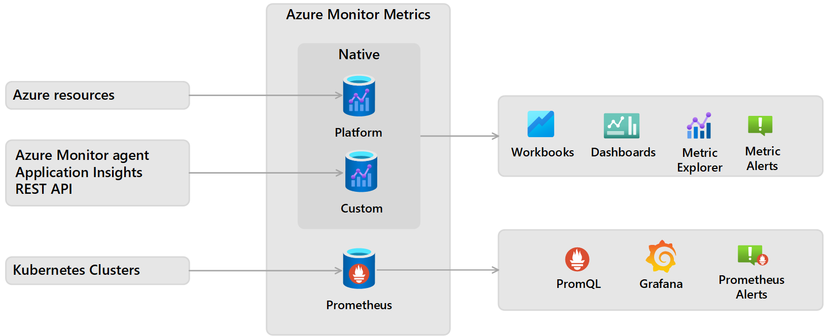
Azure Monitor Metrics
3
Notes:
https://learn.microsoft.com/en-us/azure/azure-monitor/essentials/data-platform-metrics
Types of metrics: There are multiple types of metrics supported by Azure Monitor Metrics:
Native metrics use tools in Azure Monitor for analysis and alerting.
Platform metrics are collected from Azure resources. They require no configuration and have no cost.
Custom metrics are collected from different sources that you configure including applications and agents running on virtual machines.
Prometheus metrics are collected from Kubernetes clusters including Azure Kubernetes service (AKS) and use industry standard tools for analyzing and alerting such as PromQL and Grafana.
Data structure: Data that Azure Monitor Metrics collects, is stored in a time-series database that's optimized for analyzing time-stamped data. Each set of metric values is a time series with the following properties:
The time when the value was collected.
The resource that the value is associated with.
A namespace that acts like a category for the metric.
A metric name.
The value itself.
Multiple dimensions when they're present. Custom metrics are limited to 10 dimensions.
Retention of metrics
Platform and custom metrics are stored for 93 days (with some exceptions)
Prometheus metrics are stored for 18 months, but a PromQL query can only span a maximum of 32 days.

Slide 14
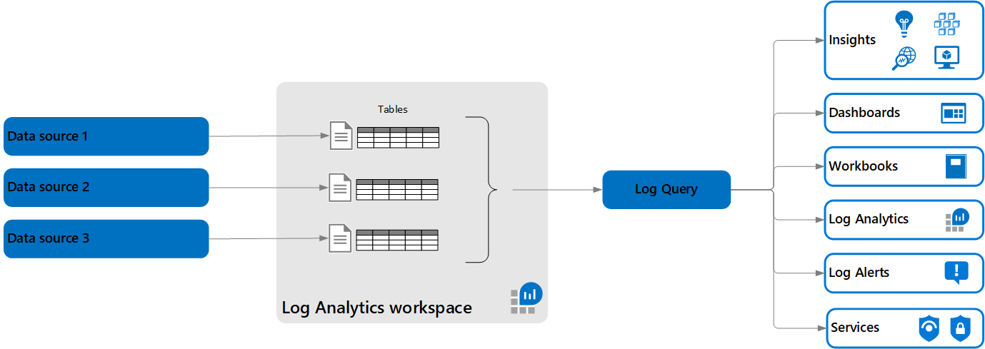

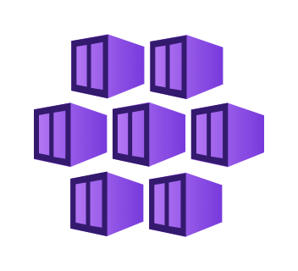
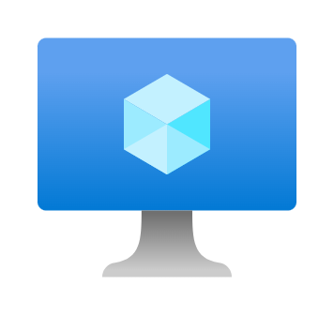



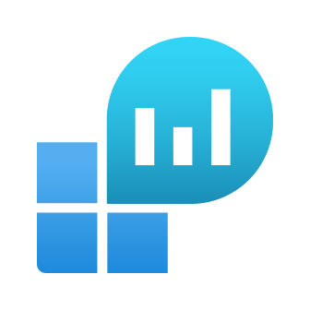

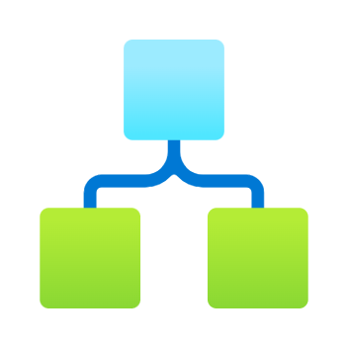


Azure Monitor Logs
3
Notes:
https://learn.microsoft.com/en-us/azure/azure-monitor/logs/data-platform-logs
Log Analytics workspaces: Azure Monitor Logs stores the data that it collects in one or more Log Analytics workspaces. You must create at least one workspace to use Azure Monitor Logs. For a description of Log Analytics workspaces, see Log Analytics workspace overview.
Log Analytics: Log Analytics is a tool in the Azure portal. Use it to edit and run log queries and interactively analyze their results. You can then use those queries to support other features in Azure Monitor, such as log query alerts and workbooks. Access Log Analytics from the Logs option on the Azure Monitor menu or from most other services in the Azure portal.
Log queries: Data is retrieved from a Log Analytics workspace through a log query, which is a read-only request to process data and return results. Log queries are written in Kusto Query Language (KQL). KQL is the same query language that Azure Data Explorer uses. You can:
Write log queries in Log Analytics to interactively analyze their results.
Use them in alert rules to be proactively notified of issues.
Include their results in workbooks or dashboards.
Insights include prebuilt queries to support their views and workbooks.
Relationship to Azure Data Explorer: Azure Monitor Logs is based on Azure Data Explorer. A Log Analytics workspace is roughly the equivalent of a database in Azure Data Explorer. Tables are structured the same, and both use KQL. The experience of using Log Analytics to work with Azure Monitor queries in the Azure portal is similar to the experience of using the Azure Data Explorer Web UI. You can even include data from a Log Analytics workspace in an Azure Data Explorer query.
Data structure: Each workspace contains multiple tables that are organized into separate columns with multiple rows of data. Each table is defined by a unique set of columns. Rows of data provided by the data source share those columns. Log queries define columns of data to retrieve and provide output to different features of Azure Monitor and other services that use workspaces.

Slide 15
Azure Monitor overview
1
2
3
4
4.1
4.2
4.3
4.4
7
6
5
Notes:
https://learn.microsoft.com/en-us/azure/azure-monitor/overview
So how does Azure Monitor work.
It all starts with collecting telemetry. Azure Monitor can collect data from Application, Network, Infrastructure and you can also ingest your own custom data. All the data is stored in centralized, fully managed logs and metrics stores. So, what can you do with all the data:
Typically, you start with insights which are end to end experiences we have put together for canonical scenarios or resources such as applications, containers, VMs, network, storage etc. Insights provide guidance and help troubleshoot and root cause issues quickly with a drill down experience.
You may in certain cases, just want to visualize the data. For that we provide Azure dashboards, Power BI integrations and a more native experience called Workbooks.
After visualizing the data, you may form some hypothesis and want to test them out. For that you need access to the raw data stores. For that we provide metrics explorer and a powerful big data platform called Log Analytics that is capable of querying petabytes of data within seconds.
If you want to pro-active and take corrective actions, you can create alerts and runbooks to auto remedy an issue. Or if it’s a capacity issue, you can choose to scale-in or scale-out
Finally, we know that monitoring isn’t done is silos. Azure Monitor provides out of the box integration with popular ITSM and DevOps tools. You can again use APIs, EventHub and Logic Apps to build custom integrations.

Slide 16
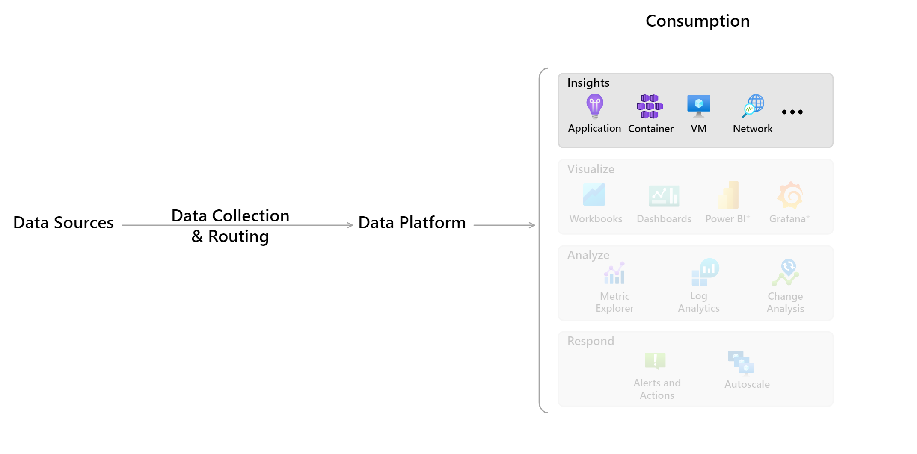
Azure Monitor Insights
4.1
Notes:
https://learn.microsoft.com/en-us/azure/azure-monitor/overview#insights
https://learn.microsoft.com/en-us/azure/azure-monitor/insights/insights-overview
Some Azure resource providers have curated visualizations that provide a customized monitoring experience and require minimal configuration. Insights are large, scalable, curated visualizations.

Slide 17
Azure Monitor Insights List
4.1
Compute
Azure VM Insights
Azure Container Insights
Networking
Azure Network Insights
Storage
Azure Storage Insights
Azure Backup
Databases
Azure Cosmos DB Insights
Azure Monitor for Azure Cache for Redis
Analytics
Azure Data Explorer Insights
Azure Monitor Log Analytics Workspace
Security
Azure Key Vault Insights
Monitor
Azure Monitor Application Insights
Azure Activity Log Insights
Azure Monitor for Resource Groups
Integration
Azure Service Bus Insights
Azure IoT Edge
Workloads
Azure SQL Insights
Azure Monitor for SAP solutions
Other
Azure Virtual Desktop Insights
Azure Stack HCI Insights
Windows Update for Business
Azure Monitor Workbooks for Azure Active Directory
Azure HDInsight
Notes:
https://learn.microsoft.com/en-us/azure/azure-monitor/insights/insights-overview
Some services have a curated monitoring experience. That is, Microsoft provides customized functionality meant to act as a starting point for monitoring those services. These experiences are collectively known as curated visualizations with the larger more complex of them being called Insights.
The experiences collect and analyze a subset of available telemetry for a given service(s). Depending on the service, the experiences might also provide out-of-the-box alerting. They present the telemetry in a visual layout. The visualizations vary in size and scale.
Some visualizations are considered part of Azure Monitor and follow the support and service level agreements for Azure. They're supported in all Azure regions where Azure Monitor is available. Other curated visualizations provide less functionality, might not scale, and might have different agreements. Some might be based solely on Azure Monitor Workbooks, while others might have an extensive custom experience.
The following table lists the available curated visualizations. Most of the list below can be found in the Insights hub in the Azure portal. The table uses the same grouping as portal.
Compute
Azure VM Insights: Monitors your Azure VMs and Virtual Machine Scale Sets at scale. It analyzes the performance and health of your Windows and Linux VMs and monitors their processes and dependencies on other resources and external processes.
Azure Container Insights: Monitors the performance of container workloads that are deployed to managed Kubernetes clusters hosted on Azure Kubernetes Service. It gives you performance visibility by collecting metrics from controllers, nodes, and containers that are available in Kubernetes through the Metrics API. Container logs are also collected. After you enable monitoring from Kubernetes clusters, these metrics and logs are automatically collected for you through a containerized version of the Log Analytics agent for Linux.
Networking
Azure Network Insights: Provides a comprehensive view of health and metrics for all your network resources. The advanced search capability helps you identify resource dependencies, enabling scenarios like identifying resources that are hosting your website, by searching for your website name.
Storage
Azure Storage Insights: Provides comprehensive monitoring of your Azure Storage accounts by delivering a unified view of your Azure Storage services performance, capacity, and availability.
Azure Backup: Provides built-in monitoring and alerting capabilities in a Recovery Services vault.
Databases
Azure Cosmos DB Insights: Provides a view of the overall performance, failures, capacity, and operational health of all your Azure Cosmos DB resources in a unified interactive experience.
Azure Monitor for Azure Cache for Redis: Provides a unified, interactive view of overall performance, failures, capacity, and operational health.
Analytics
Azure Data Explorer Insights: Azure Data Explorer Insights provides comprehensive monitoring of your clusters by delivering a unified view of your cluster performance, operations, usage, and failures.
Azure Monitor Log Analytics Workspace: Log Analytics Workspace Insights (preview) provides comprehensive monitoring of your workspaces through a unified view of your workspace usage, performance, health, agent, queries, and change log. This article will help you understand how to onboard and use Log Analytics Workspace Insights (preview).
Security
Azure Key Vault Insights: Provides comprehensive monitoring of your key vaults by delivering a unified view of your Key Vault requests, performance, failures, and latency.
Monitor
Azure Monitor Application Insights: Extensible application performance management service that monitors the availability, performance, and usage of your web applications whether they're hosted in the cloud or on-premises. It uses the powerful data analysis platform in Azure Monitor to provide you with deep insights into your application's operations. It enables you to diagnose errors without waiting for a user to report them. Application Insights includes connection points to various development tools and integrates with Visual Studio to support your DevOps processes.
Azure activity Log Insights: Provides built-in monitoring and alerting capabilities in a Recovery Services vault.
Azure Monitor for Resource Groups: Triage and diagnose any problems your individual resources encounter, while offering context for the health and performance of the resource group as a whole.
Integration
Azure Service Bus Insights: Azure Service Bus Insights provide a view of the overall performance, failures, capacity, and operational health of all your Service Bus resources in a unified interactive experience.
Azure IoT Edge: Visualize and explore metrics collected from the IoT Edge device right in the Azure portal by using Azure Monitor Workbooks-based public templates. The curated workbooks use built-in metrics from the IoT Edge runtime. These views don't need any metrics instrumentation from the workload modules.
Workloads
Azure SQL Insights: A comprehensive interface for monitoring any product in the Azure SQL family. SQL Insights uses dynamic management views to expose the data you need to monitor health, diagnose problems, and tune performance. Note: If you're just setting up SQL monitoring, use SQL Insights instead of the SQL Analytics solution.
Azure Monitor for SAP solutions: An Azure-native monitoring product for anyone running their SAP landscapes on Azure. It works with both SAP on Azure Virtual Machines and SAP on Azure Large Instances. Collects telemetry data from Azure infrastructure and databases in one central location and visually correlates the data for faster troubleshooting. You can monitor different components of an SAP landscape, such as Azure virtual machines (VMs), high-availability clusters, SAP HANA database, and SAP NetWeaver, by adding the corresponding provider for that component.
Other
Azure Virtual Desktop Insights: Azure Virtual Desktop Insights is a dashboard built on Azure Monitor Workbooks that helps IT professionals understand their Azure Virtual Desktop environments.
Azure Stack HCI Insights: Based on Azure Monitor Workbooks. Provides health, performance, and usage insights about registered Azure Stack HCI version 21H2 clusters that are connected to Azure and enrolled in monitoring. It stores its data in a Log Analytics workspace, which allows it to deliver powerful aggregation and filtering and analyze data trends over time.
Windows Update for Business: Detailed deployment monitoring, compliance assessment and failure troubleshooting for all Windows 10/11 devices.
Not in Azure portal Insight hub
Azure Monitor Workbooks for Azure Active Directory: Azure Active Directory provides workbooks to understand the effect of your Conditional Access policies, troubleshoot sign-in failures, and identify legacy authentications.
Azure HDInsigh: An Azure Monitor workbook that collects important performance metrics from your HDInsight cluster and provides the visualizations and dashboards for most common scenarios. Gives a complete view of a single HDInsight cluster including resource utilization and application status.

Slide 18
Application monitoring

Slide 19
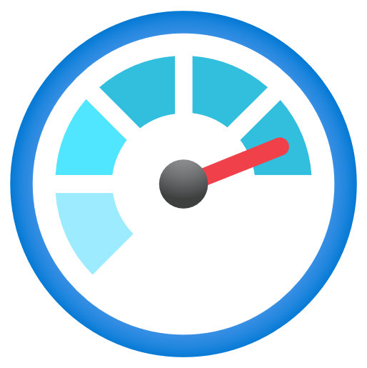
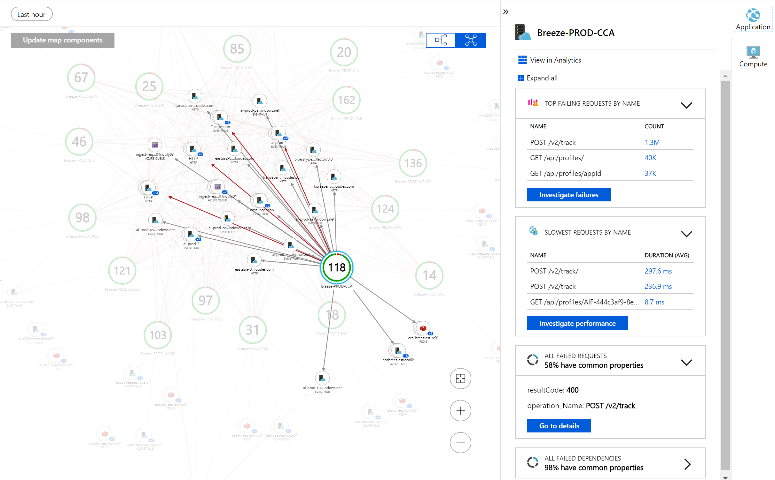
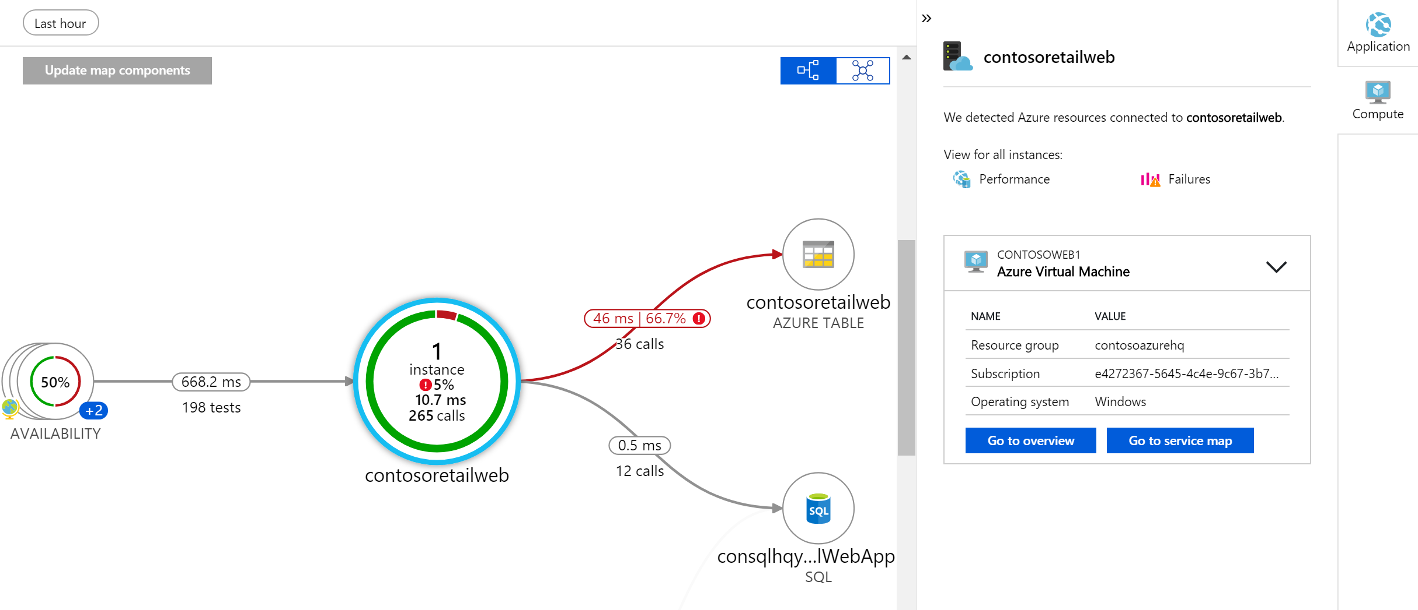
Application monitoring
Azure Monitor
Available on-by-default for Azure App Services and Functions (.NET)
Visualize events and metrics in real time with Live Metrics Stream
Visualize server/client connections and dependencies with App Map
Transition with 1-click from App Map to VM Map for diagnostics
Understand end-user cohorts, behavior, and engagement for planning
Monitor apps in .NET, JS, Java, Node.js or any other language with OSS SDKs

Slide 20
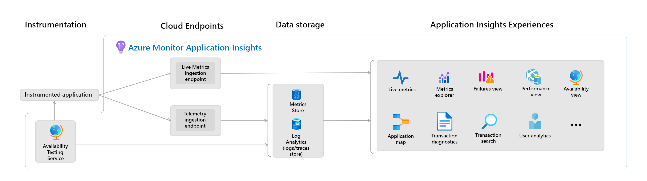
Application Insights
4.1
Notes:
https://learn.microsoft.com/en-us/azure/azure-monitor/app/app-insights-overview?tabs=net
https://review.learn.microsoft.com/en-us/asm-demo-script/script/cloud-management-monitor-application-insights-.net-demo-script?branch=main
https://review.learn.microsoft.com/en-us/asm-demo-script/script/cloud-management-monitor-application-insights-polyglot-demo-script?branch=main
Application Insights monitors the availability, performance, and usage of your web applications.
Application Insights is an extension of Azure Monitor and provides application performance monitoring (APM) features. APM tools are useful to monitor applications from development, through test, and into production in the following ways:
Proactively understand how an application is performing.
Reactively review application execution data to determine the cause of an incident.
Along with collecting metrics and application telemetry data, which describe application activities and health, you can use Application Insights to collect and store application trace logging data.
The log trace is associated with other telemetry to give a detailed view of the activity. Adding trace logging to existing apps only requires providing a destination for the logs. You rarely need to change the logging framework.
Application Insights provides other features including, but not limited to:
Live Metrics: Observe activity from your deployed application in real time with no effect on the host environment.
Availability: Also known as synthetic transaction monitoring. Probe the external endpoints of your applications to test the overall availability and responsiveness over time.
GitHub or Azure DevOps integration: Create GitHub or Azure DevOps work items in the context of Application Insights data.
Usage: Understand which features are popular with users and how users interact and use your application.
Smart detection: Detect failures and anomalies automatically through proactive telemetry analysis.
Application Insights supports distributed tracing, which is also known as distributed component correlation. This feature allows searching for and visualizing an end-to-end flow of a specific execution or transaction. The ability to trace activity from end to end is important for applications that were built as distributed components or microservices.
The Application Map allows a high-level, top-down view of the application architecture and at-a-glance visual references to component health and responsiveness.
Features:
Application dashboard
Application Map
Availability
Standard tests
Private testing
TrackAvailability()
Availability alerts
SLA report
Transaction diagnostics
Live Metric stream
Transaction search
Smart Detection
Usage (user behavior analytics)
GitHub and Azure DevOps Integration
Profiler
Code Optimizations
Snapshot Debugger

Slide 21
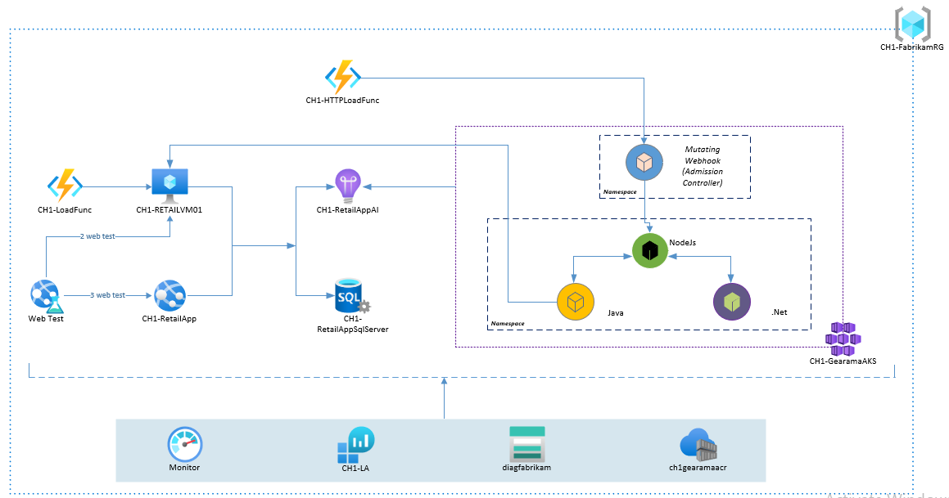
Demo Application Architecture
The following architecture has a modern microservices app in Contoso Hotels’ IT department.
A polyglot application with microservices like Java, NodeJS and .NET core running on containers orchestrated by Azure kubernetes.
These services running in an AKS cluster are connected to a single application insight instance.
Also, there are some legacy downstream services running in VM and app service connected to Azure SQL database instance.
Additionally, the application architecture uses a mix of serverless computing, such as Azure functions to generate user loads.

Slide 22
Demo Application Insights

Slide 23
Virtual Machines & Infrastructure Monitoring

Slide 24
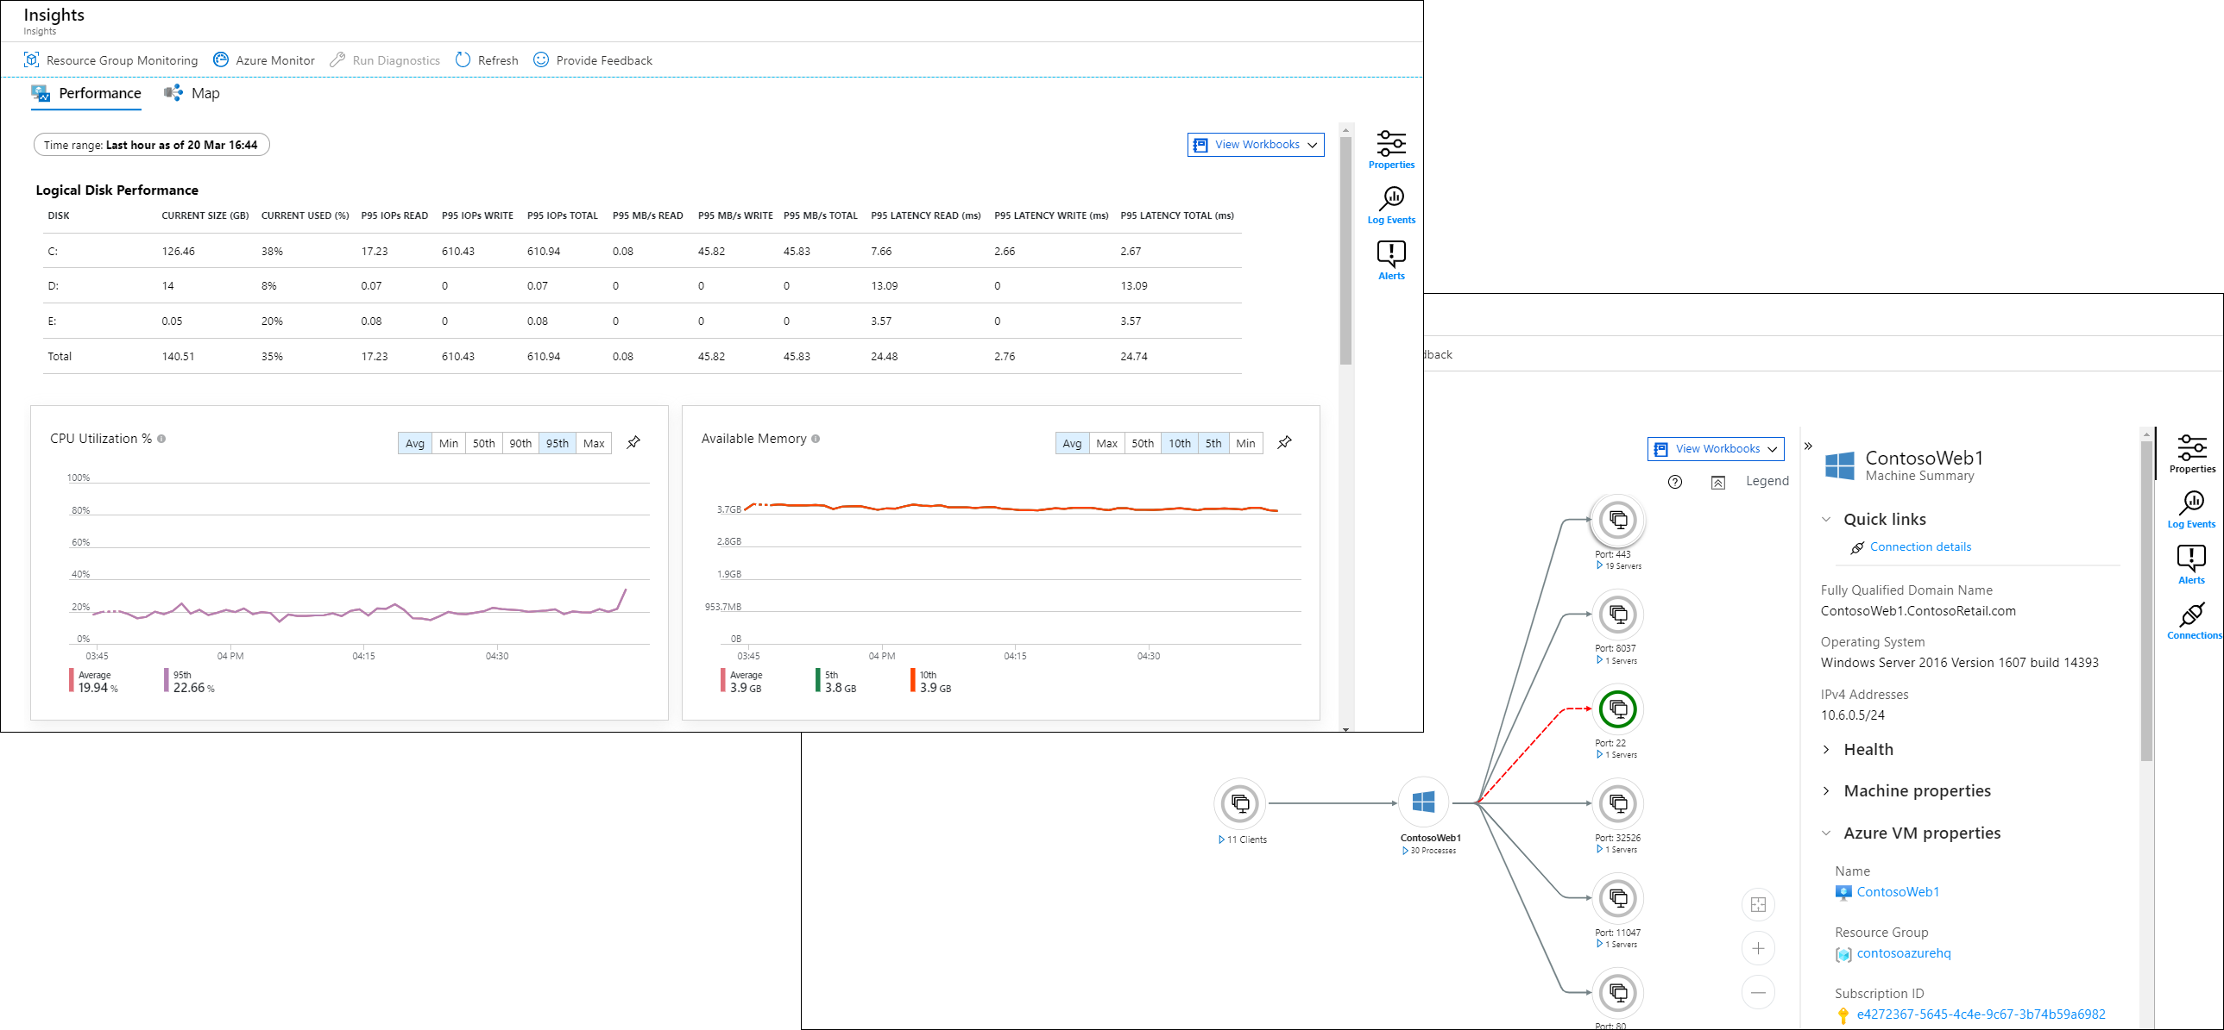
VM Insights
4.1
Notes:
https://learn.microsoft.com/en-us/azure/azure-monitor/vm/vminsights-overview
https://review.learn.microsoft.com/en-us/asm-demo-script/script/cloud-management-monitor-vm-insights?branch=main
VM insights includes a set of performance charts that target several key performance indicators to help you determine how well a virtual machine is performing.
VM insights provides a quick and easy method for getting started monitoring the client workloads on your virtual machines and virtual machine scale sets. It displays an inventory of your existing VMs and provides a guided experience to enable base monitoring for them. It also monitors the performance and health of your virtual machines and virtual machine scale sets by collecting data on their running processes and dependencies on other resources.
VM insights supports Windows and Linux operating systems on:
Azure virtual machines.
Azure virtual machine scale sets.
Hybrid virtual machines connected with Azure Arc.
On-premises virtual machines.
Virtual machines hosted in another cloud environment.
VM insights provides a set of predefined workbooks that allow you to view trending of collected performance data over time. You can view this data in a single VM from the virtual machine directly, or you can use Azure Monitor to deliver an aggregated view of multiple VMs.
DEMO >
Features:
Inventory of all your VMs (Azure, Hybrid, On-premises) and their monitoring status (monitored, or not monitored)
Onboarding options for Single VM, Azure Policy, etc.
Map dependencies: The Map feature visualizes the VM dependencies by discovering running processes that have:
Active network connections between servers.
Inbound and outbound connection latency.
Ports across any TCP-connected architecture over a specified time range.
Monitor Performance: VM insights includes a set of performance charts that target several key performance indicators to help you determine how well a virtual machine is performing.
Log queries: VM insights collects performance and connection metrics, computer and process inventory data, and health state information and forwards it to the Log Analytics workspace in Azure Monitor. This data is available for query in Azure Monitor. You can apply this data to scenarios that include migration planning, capacity analysis, discovery, and on-demand performance troubleshooting.
Change analysis: VM insights integration with Application Change Analysis integration allows you to view any changes made to a virtual machine that might have affected its performance.
Workbooks: VM insights includes the following workbooks. You can use these workbooks or use them as a starting point to create custom workbooks to address your particular requirements.
Performance: Provides a customizable version of the Top N List and Charts view in a single workbook that uses all the Log Analytics performance counters that you've enabled.
Performance counters: Provides a Top N Chart view across a wide set of performance counters.
Connections: Provides an in-depth view of the inbound and outbound connections from your monitored VMs.
Active Ports: Provides a list of the processes that have bound to the ports on the monitored VMs and their activity in the chosen time frame.
Open Ports: Provides the number of ports open on your monitored VMs and the details on those open ports.
Failed Connections: Displays the count of failed connections on your monitored VMs, the failure trend, and if the percentage of failures is increasing over time.
Security and Audit: An analysis of your TCP/IP traffic that reports on overall connections, malicious connections, and where the IP endpoints reside globally. To enable all features, you must enable Security Detection.
TCP Traffic: A ranked report for your monitored VMs and their sent, received, and total network traffic in a grid and displayed as a trend line.
Traffic Comparison: Lets you compare network traffic trends for a single machine or a group of machines.

Slide 25
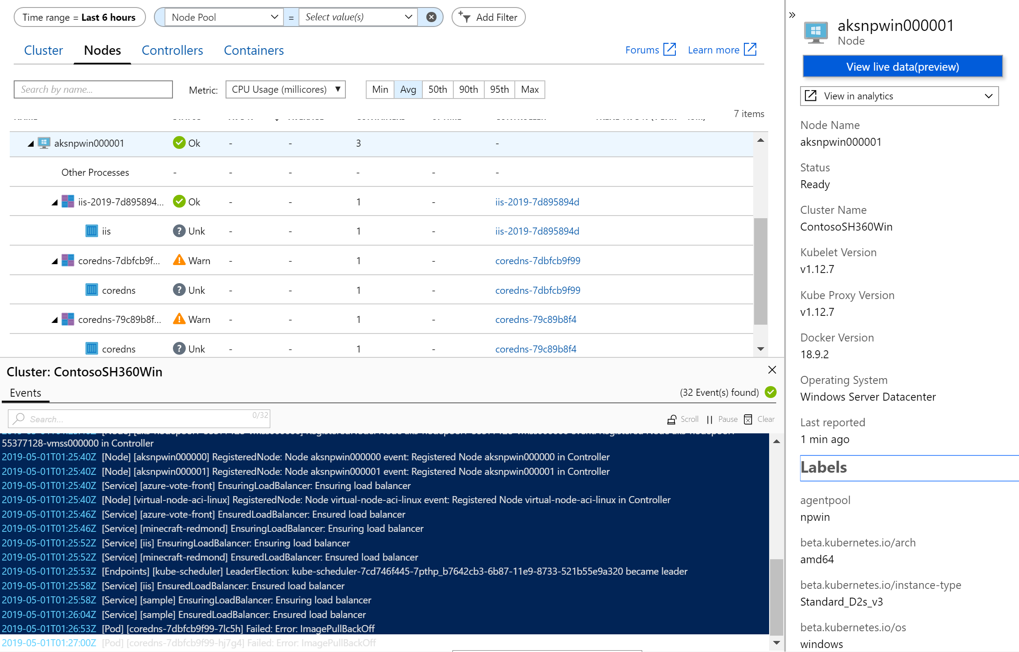
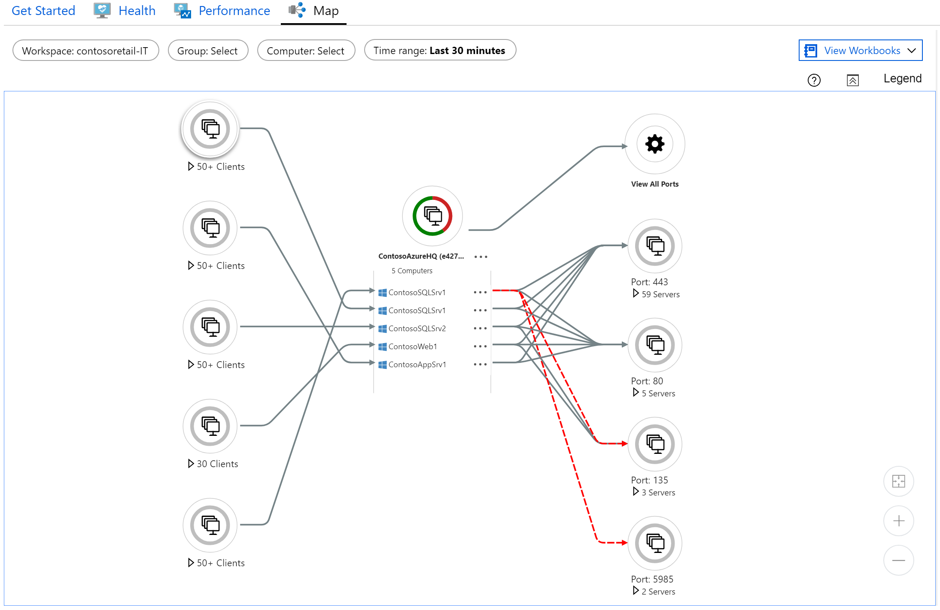
Infrastructure monitoring
Azure Monitor
Support for AKS (Windows/Linux), Virtual Node+ACI, and AKS-engine
Live Container logs, Live Kubernetes Event logs, and Prometheus metrics for observability
Monitor multi-cluster health, node status and perf across nodes, controllers, and containers
VM logs and perf counters to troubleshoot issues and identify health problems
Visualize service dependencies and connection failures in VM maps
Out-of-the-box workbooks to diagnose VM/Storage Perf Health and Network Dependencies

Slide 26
Demo VM Insights
Notes:
https://review.learn.microsoft.com/en-us/asm-demo-script/script/cloud-management-monitor-vm-insights?branch=main
Follow the demo script for VM Insights.

Slide 27
Container Insights

Slide 28
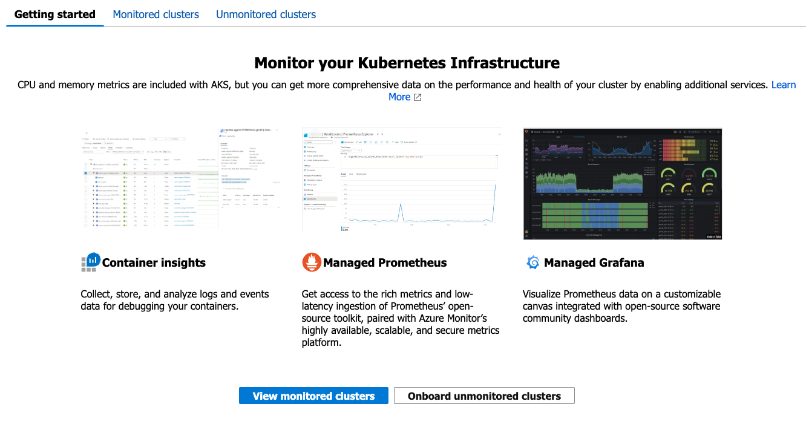
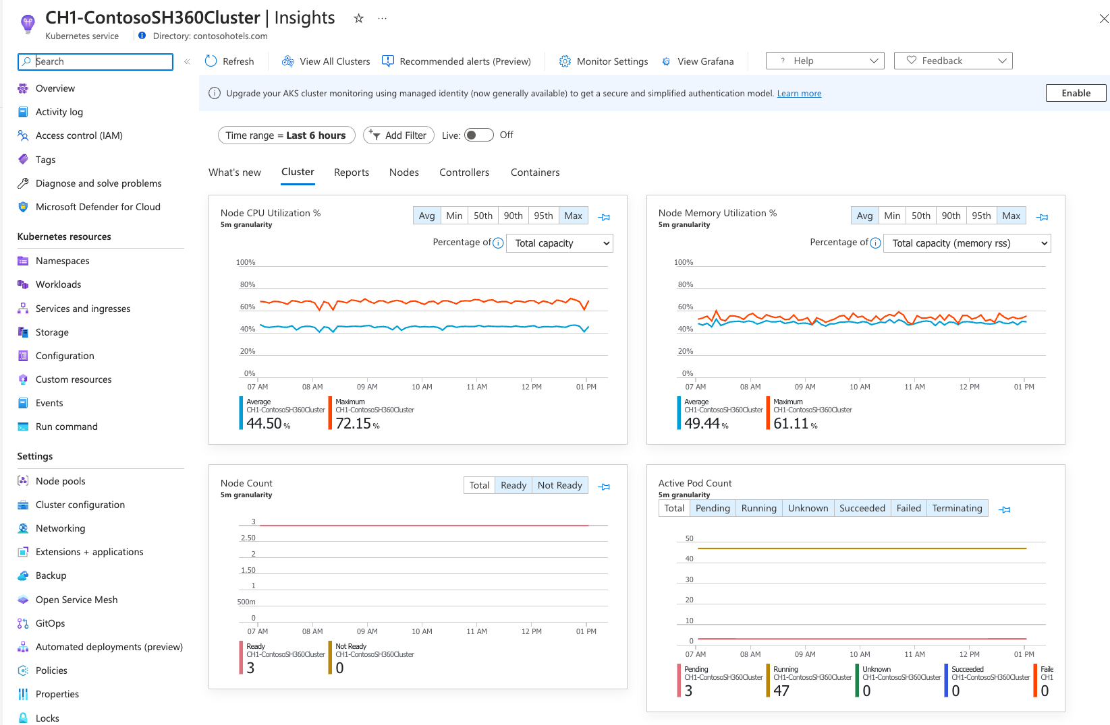
Containers Insights
4.1
Notes:
https://learn.microsoft.com/en-us/azure/azure-monitor/vm/vminsights-overview
https://review.learn.microsoft.com/en-us/asm-demo-script/script/cloud-management-monitor-vm-insights?branch=main
VM insights includes a set of performance charts that target several key performance indicators to help you determine how well a virtual machine is performing.
VM insights provides a quick and easy method for getting started monitoring the client workloads on your virtual machines and virtual machine scale sets. It displays an inventory of your existing VMs and provides a guided experience to enable base monitoring for them. It also monitors the performance and health of your virtual machines and virtual machine scale sets by collecting data on their running processes and dependencies on other resources.
VM insights supports Windows and Linux operating systems on:
Azure virtual machines.
Azure virtual machine scale sets.
Hybrid virtual machines connected with Azure Arc.
On-premises virtual machines.
Virtual machines hosted in another cloud environment.
VM insights provides a set of predefined workbooks that allow you to view trending of collected performance data over time. You can view this data in a single VM from the virtual machine directly, or you can use Azure Monitor to deliver an aggregated view of multiple VMs.
DEMO >
Features:
Inventory of all your VMs (Azure, Hybrid, On-premises) and their monitoring status (monitored, or not monitored)
Onboarding options for Single VM, Azure Policy, etc.
Map dependencies: The Map feature visualizes the VM dependencies by discovering running processes that have:
Active network connections between servers.
Inbound and outbound connection latency.
Ports across any TCP-connected architecture over a specified time range.
Monitor Performance: VM insights includes a set of performance charts that target several key performance indicators to help you determine how well a virtual machine is performing.
Log queries: VM insights collects performance and connection metrics, computer and process inventory data, and health state information and forwards it to the Log Analytics workspace in Azure Monitor. This data is available for query in Azure Monitor. You can apply this data to scenarios that include migration planning, capacity analysis, discovery, and on-demand performance troubleshooting.
Change analysis: VM insights integration with Application Change Analysis integration allows you to view any changes made to a virtual machine that might have affected its performance.
Workbooks: VM insights includes the following workbooks. You can use these workbooks or use them as a starting point to create custom workbooks to address your particular requirements.
Performance: Provides a customizable version of the Top N List and Charts view in a single workbook that uses all the Log Analytics performance counters that you've enabled.
Performance counters: Provides a Top N Chart view across a wide set of performance counters.
Connections: Provides an in-depth view of the inbound and outbound connections from your monitored VMs.
Active Ports: Provides a list of the processes that have bound to the ports on the monitored VMs and their activity in the chosen time frame.
Open Ports: Provides the number of ports open on your monitored VMs and the details on those open ports.
Failed Connections: Displays the count of failed connections on your monitored VMs, the failure trend, and if the percentage of failures is increasing over time.
Security and Audit: An analysis of your TCP/IP traffic that reports on overall connections, malicious connections, and where the IP endpoints reside globally. To enable all features, you must enable Security Detection.
TCP Traffic: A ranked report for your monitored VMs and their sent, received, and total network traffic in a grid and displayed as a trend line.
Traffic Comparison: Lets you compare network traffic trends for a single machine or a group of machines.

Slide 29
CONTAINERS INSIGHTS
DEMO

Slide 30
Network Monitoring

Slide 31
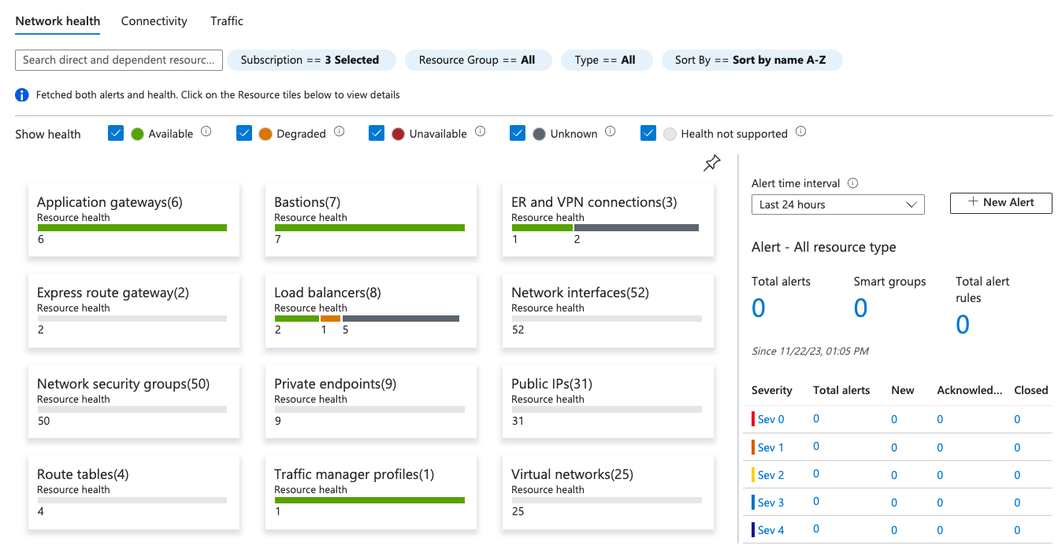
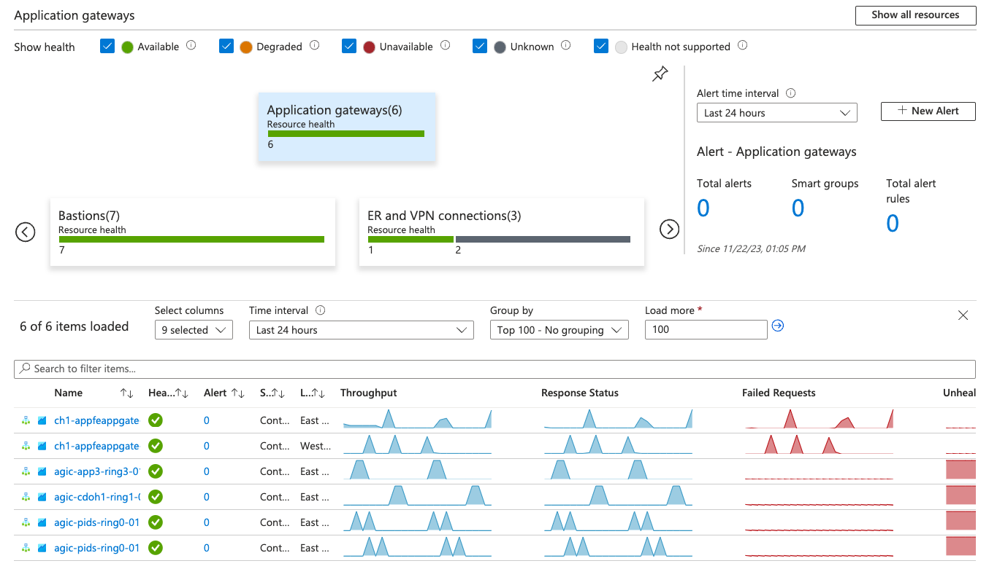
Network Insights

Slide 32
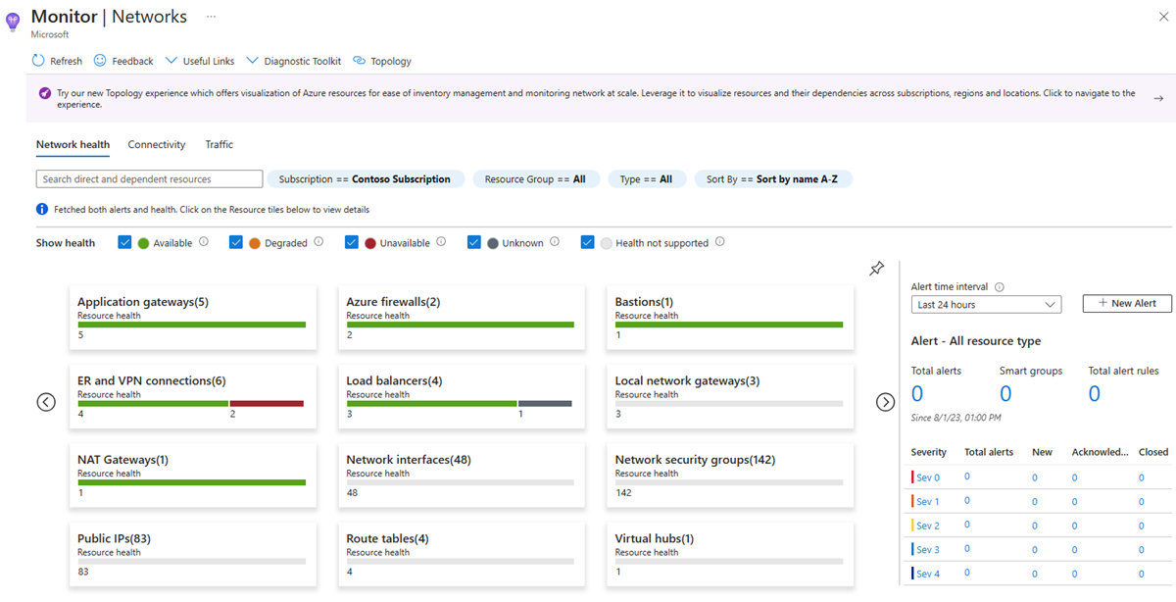
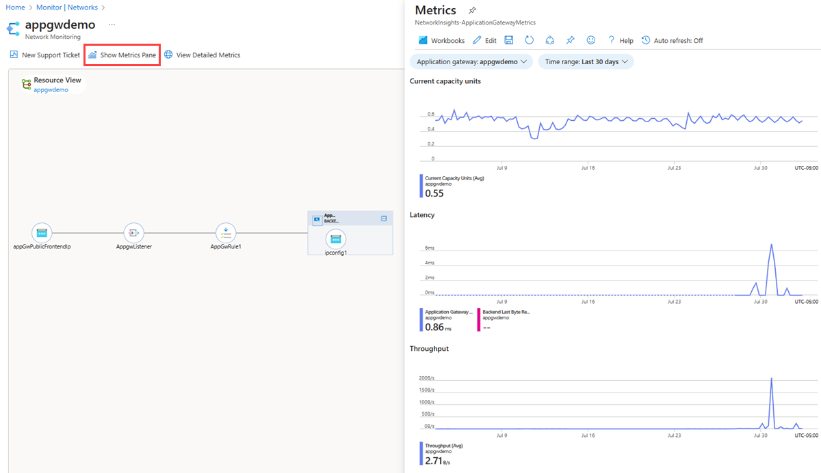
Network Insights
4.1
Notes:
https://learn.microsoft.com/en-us/azure/network-watcher/network-insights-overview
https://review.learn.microsoft.com/en-us/asm-demo-script/script/azureresources/monitoring/cloud-management-azure-resources-networking-azure-network-watcher?branch=main
DEMO
Azure Monitor Network Insights provides a comprehensive and visual representation through topology, health and metrics for all deployed network resources, without requiring any configuration. It also provides access to network monitoring capabilities like Connection monitor, NSG flow logs, and Traffic analytics. Additionally, it provides other network diagnostic features.
Azure Monitor Network Insights is structured around these key components of monitoring:
Topology: Topology helps you visualize how a resource is configured. It provides a graphic representation of the entire hybrid network for understanding network configuration. Topology is a unified visualization tool for resource inventory and troubleshooting. It provides an interactive interface to view resources and their relationships in Azure, spanning across multiple subscriptions, resource groups, and locations. You can also drill down to the basic unit of each topology and view the resource view diagram of each unit.
Network health and metrics: The Azure Monitor network insights page provides an easy way to visualize the inventory of your networking resources, together with resource health and alerts. It's divided into four key functional areas: search and filtering, resource health and metrics, alerts, and resource view.
Connectivity: The Connectivity tab provides an easy way to visualize all tests configured via Connection monitor and Connection monitor (classic) for the selected set of subscriptions.
Traffic: The Traffic tab lists all network security groups in the selected subscriptions, resource groups and locations and it shows the ones configured for NSG flow logs and Traffic analytics. The search functionality provided on this tab enables you to identify the network security groups configured for the searched IP address. You can search for any IP address in your environment. The tiled regional view displays all network security groups along with the NSG flow logs and Traffic analytics configuration status.
Diagnostic Toolkit: Diagnostic Toolkit provides access to all the diagnostic features available for troubleshooting the network. You can use this drop-down list to access features like packet capture, VPN troubleshooting, connection troubleshooting, next hop, and IP flow verify:
Availability of resources: By default, all networking resources are visible in Azure Monitor network insights. You can select the resource type for viewing resource health and metrics (if available), subscription details, location, etc. A subset of networking resources has been Onboarded. For Onboarded resources, you have access to a resource specific topology view and a built-in metrics workbook. These out-of-the-box experiences make it easier to explore resource metrics and troubleshoot issues.

Slide 33

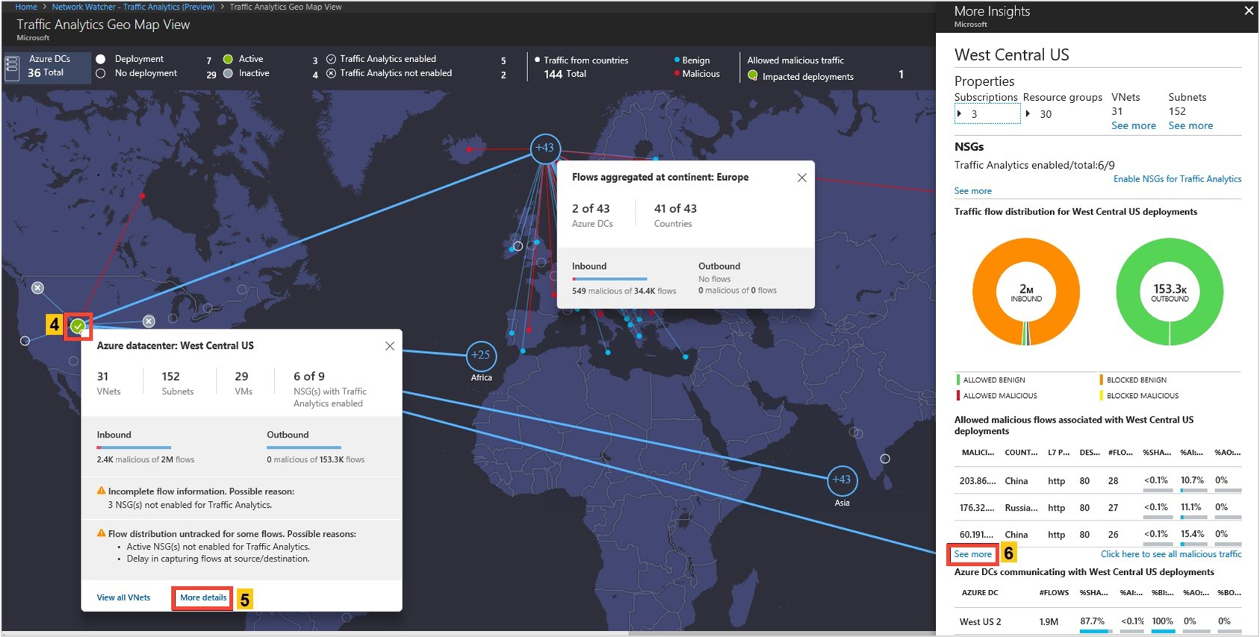
Monitor network health and traffic
Azure Network Watcher
Secure and audit your network with Network Watcher Traffic Analytics
Discover and monitor ExpressRoute circuits, across subscriptions
Monitor ExpressRoute connectivity to virtual networks and O365
Monitor connectivity to LoB apps with Service Connectivity Monitor
Notes:
Azure provides network troubleshooting and monitoring capabilities
Our solutions can monitor networks In Azure, hybrid and on-premises networks
We have released several new monitoring capabilities, since previous Ignite:
Traffic Analytics - Network Watcher enables the generation of traffic flow logs corresponding to Network Security Groups set up by customers. These flow logs are used as the basis by the Traffic Analytics solution to visualize traffic flow characteristics into/out of customers’ virtual networks, correlated with other information such as malicious IP. TA gives insights for capacity planning, traffic flow audit and identifying anomalies.
NPM can now monitor ExpressRoute circuits and connectivity to SaaS and LoB applications
ExpressRoute - ExpressRoute is a key connectivity solution offered to connect customer premises with Azure using high-bandwidth private connectivity. Customers can monitor the characteristics of their ER connections including loss/latency/bandwidth utilization as well as topology details and usage of primary and secondary ER connections.
Service Connectivity Monitor - Customers can also monitor connectivity to cloud services, such as O365 and Salesforce.
All of the above solutions are generally available.
Network Watcher is a cloud-based solution for troubleshooting and monitoring networks in Azure. Use it to:
Troubleshoot and localize connectivity issues.
Perform packet captures to detect application behavior.
Check configuration (for example, routing) issues in complex topology environments.
Audit your networks with network security group flow logs and Traffic Analytics (see available regions).
Monitor network connectivity within the cloud and across hybrid environments using Azure Connection Monitor and Azure Network Performance Monitor.

Slide 34
Demo Network Insights
Notes:
https://learn.microsoft.com/en-us/azure/network-watcher/network-insights-overview
https://review.learn.microsoft.com/en-us/asm-demo-script/script/azureresources/monitoring/cloud-management-azure-resources-networking-azure-network-watcher?branch=main
Follow the document script for Network Insights demo.
You can go further with Network Capture if necessary.

Slide 35
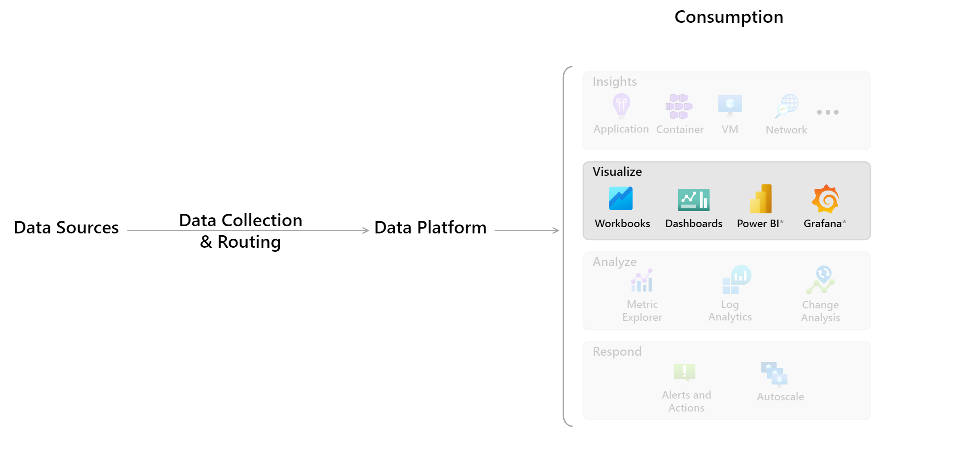
Visualize
4.2
Notes:
https://learn.microsoft.com/en-us/azure/azure-monitor/overview#visualize
https://learn.microsoft.com/en-us/azure/azure-monitor/visualize/workbooks-overview
https://learn.microsoft.com/en-us/azure/azure-monitor/visualize/grafana-plugin
https://learn.microsoft.com/en-us/azure/azure-monitor/visualize/tutorial-logs-dashboards
https://learn.microsoft.com/en-us/azure/azure-monitor/logs/log-powerbi
Visualizations such as charts and tables are effective tools for summarizing monitoring data and presenting it to different audiences. Azure Monitor has its own features for visualizing monitoring data and uses other Azure services for publishing it to different audiences. Power BI and Grafana are not officially part of the Azure Monitor product, but they're a core integration and part of the Azure Monitor story.
Dashboards: Azure dashboards allow you to combine different kinds of data into a single pane in the Azure portal. You can optionally share the dashboard with other Azure users. You can add the output of any log query or metrics chart to an Azure dashboard. For example, you could create a dashboard that combines tiles that show a graph of metrics, a table of activity logs, a usage chart from Application Insights, and the output of a log query.
Workbooks: Workbooks provide a flexible canvas for data analysis and the creation of rich visual reports in the Azure portal. You can use them to query data from multiple data sources. Workbooks can combine and correlate data from multiple data sets in one visualization giving you easy visual representation of your system. Workbooks are interactive and can be shared across teams with data updating in real time. Use workbooks provided with Insights, utilize the library of templates, or create your own.
Power BI: Power BI is a business analytics service that provides interactive visualizations across various data sources. It's an effective means of making data available to others within and outside your organization. You can configure Power BI to automatically import log data from Azure Monitor to take advantage of these visualizations.
Grafana: Grafana is an open platform that excels in operational dashboards. All versions of Grafana include the Azure Monitor data source plug-in to visualize your Azure Monitor metrics and logs. Azure Managed Grafana also optimizes this experience for Azure-native data stores such as Azure Monitor and Azure Data Explorer. In this way, you can easily connect to any resource in your subscription and view all resulting monitoring data in a familiar Grafana dashboard. It also supports pinning charts from Azure Monitor metrics and logs to Grafana dashboards. Grafana has popular plug-ins and dashboard templates for non-Microsoft APM tools such as Dynatrace, New Relic, and AppDynamics as well. You can use these resources to visualize Azure platform data alongside other metrics from higher in the stack collected by these other tools. It also has AWS CloudWatch and GCP BigQuery plug-ins for multicloud monitoring in a single pane of glass.

Slide 36
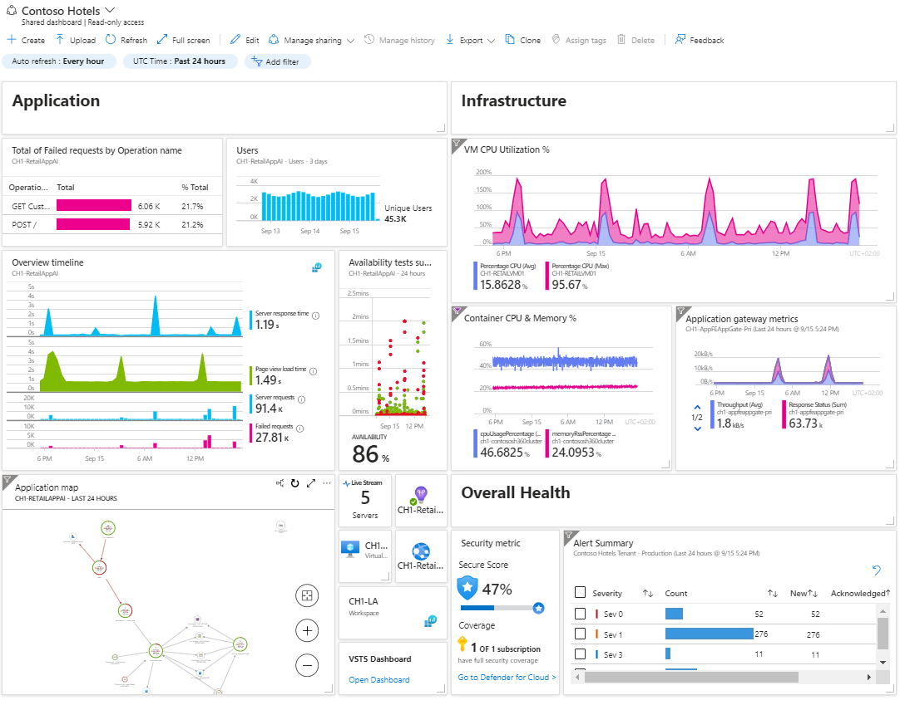
Dashboards
4.2
Notes:
https://learn.microsoft.com/en-us/azure/azure-monitor/overview#visualize
https://learn.microsoft.com/en-us/azure/azure-monitor/visualize/tutorial-logs-dashboards
https://learn.microsoft.com/en-us/azure/azure-monitor/app/tutorial-app-dashboards
Dashboards: Azure dashboards allow you to combine different kinds of data into a single pane in the Azure portal. You can optionally share the dashboard with other Azure users. You can add the output of any log query or metrics chart to an Azure dashboard. For example, you could create a dashboard that combines tiles that show a graph of metrics, a table of activity logs, a usage chart from Application Insights, and the output of a log query.
Log Analytics dashboards can visualize all of your saved log queries. Visualizations give you the ability to find, correlate, and share IT operational data in your organization.
Application data: You can pin different charts and views from Application Insights to create custom dashboards that provide you with a complete picture of the health and performance of your application.

Slide 37
Demo
Azure Monitor Dashboards
Notes:
https://learn.microsoft.com/en-us/azure/azure-monitor/overview#visualize
https://learn.microsoft.com/en-us/azure/azure-monitor/visualize/tutorial-logs-dashboards
https://learn.microsoft.com/en-us/azure/azure-monitor/app/tutorial-app-dashboards
Follow the documentation script for Azure Monitor Dashboard and show Contoso Hotel Production Dashboard.

Slide 38
Visualize
4.2
Notes:
https://learn.microsoft.com/en-us/azure/azure-monitor/overview#visualize
https://learn.microsoft.com/en-us/azure/azure-monitor/visualize/workbooks-overview
https://learn.microsoft.com/en-us/azure/azure-monitor/visualize/grafana-plugin
https://learn.microsoft.com/en-us/azure/azure-monitor/visualize/tutorial-logs-dashboards
https://learn.microsoft.com/en-us/azure/azure-monitor/logs/log-powerbi
Visualizations such as charts and tables are effective tools for summarizing monitoring data and presenting it to different audiences. Azure Monitor has its own features for visualizing monitoring data and uses other Azure services for publishing it to different audiences. Power BI and Grafana are not officially part of the Azure Monitor product, but they're a core integration and part of the Azure Monitor story.
Dashboards: Azure dashboards allow you to combine different kinds of data into a single pane in the Azure portal. You can optionally share the dashboard with other Azure users. You can add the output of any log query or metrics chart to an Azure dashboard. For example, you could create a dashboard that combines tiles that show a graph of metrics, a table of activity logs, a usage chart from Application Insights, and the output of a log query.
Workbooks: Workbooks provide a flexible canvas for data analysis and the creation of rich visual reports in the Azure portal. You can use them to query data from multiple data sources. Workbooks can combine and correlate data from multiple data sets in one visualization giving you easy visual representation of your system. Workbooks are interactive and can be shared across teams with data updating in real time. Use workbooks provided with Insights, utilize the library of templates, or create your own.
Power BI: Power BI is a business analytics service that provides interactive visualizations across various data sources. It's an effective means of making data available to others within and outside your organization. You can configure Power BI to automatically import log data from Azure Monitor to take advantage of these visualizations.
Grafana: Grafana is an open platform that excels in operational dashboards. All versions of Grafana include the Azure Monitor data source plug-in to visualize your Azure Monitor metrics and logs. Azure Managed Grafana also optimizes this experience for Azure-native data stores such as Azure Monitor and Azure Data Explorer. In this way, you can easily connect to any resource in your subscription and view all resulting monitoring data in a familiar Grafana dashboard. It also supports pinning charts from Azure Monitor metrics and logs to Grafana dashboards. Grafana has popular plug-ins and dashboard templates for non-Microsoft APM tools such as Dynatrace, New Relic, and AppDynamics as well. You can use these resources to visualize Azure platform data alongside other metrics from higher in the stack collected by these other tools. It also has AWS CloudWatch and GCP BigQuery plug-ins for multicloud monitoring in a single pane of glass.

Slide 39
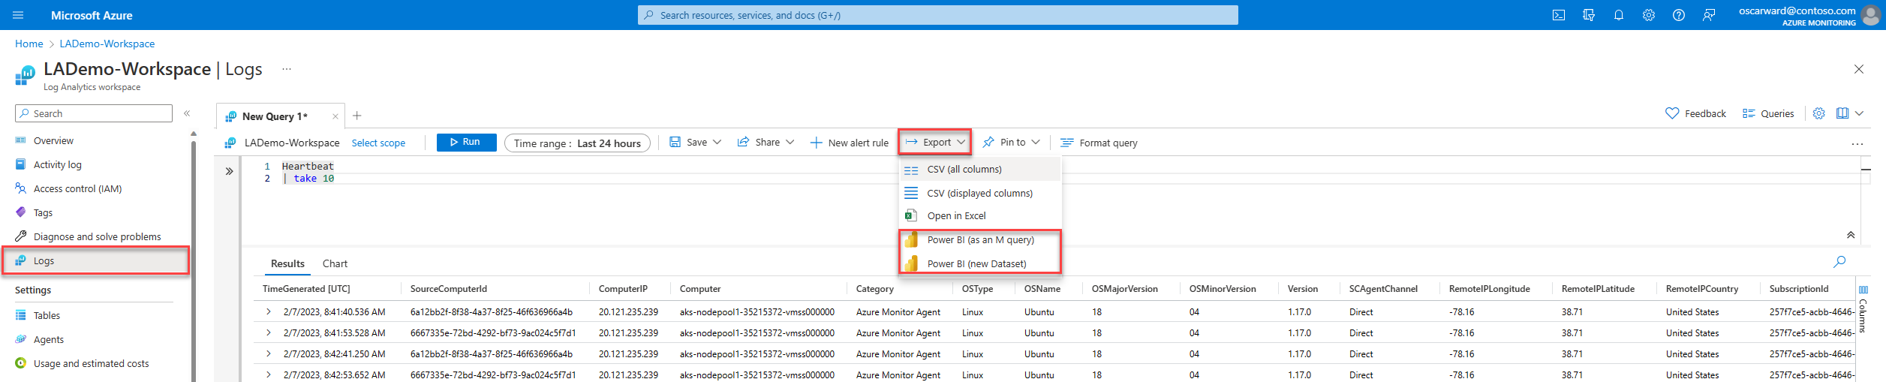
Power BI
4.2
Notes:
https://learn.microsoft.com/en-us/azure/azure-monitor/overview#visualize
https://learn.microsoft.com/en-us/azure/azure-monitor/logs/log-powerbi
Azure Monitor Logs provides an end-to-end solution for ingesting logs. From Log Analytics, Azure Monitor's user interface for querying logs, you can connect log data to Microsoft's Power BI data visualization platform.
Feed data from Log Analytics into Power BI to produce reports and dashboards based on log data.
Create Power BI datasets and reports from Log Analytics queries:
Power BI (as an M query): This option exports the query (together with the connection string for the query) to a .txt file that you can use in Power BI Desktop. Use this option if you need to model or transform the data in ways that aren't available in the Power BI service. Otherwise, consider exporting the query as a new dataset.
Power BI (new Dataset): This option creates a new dataset based on your query directly in the Power BI service. After the dataset has been created, you can create reports, use Analyze in Excel, share it with others, and use other Power BI features.
Collect data with Power BI dataflows:
Power BI dataflows also allow you to collect and store data. A dataflow is a type of cloud ETL (extract, transform, and load) process that helps you collect and prepare your data. A dataset is the "model" designed to help you connect different entities and model them for your needs.
Incremental refresh:
Both Power BI datasets and Power BI dataflows have an incremental refresh option. Power BI dataflows and Power BI datasets support this feature. To use incremental refresh on dataflows, you need Power BI Premium.
Incremental refresh runs small queries and updates smaller amounts of data per run instead of ingesting all the data again and again when you run the query. You can save large amounts of data but add a new increment of data every time the query is run. This behavior is ideal for longer-running reports.
Power BI incremental refresh relies on the existence of a datetime field in the result set. Before you configure incremental refresh, make sure your Log Analytics query result set includes at least one datetime field.
Reports and dashboards
After your data is sent to Power BI, you can continue to use Power BI to create reports and dashboards.

Slide 40
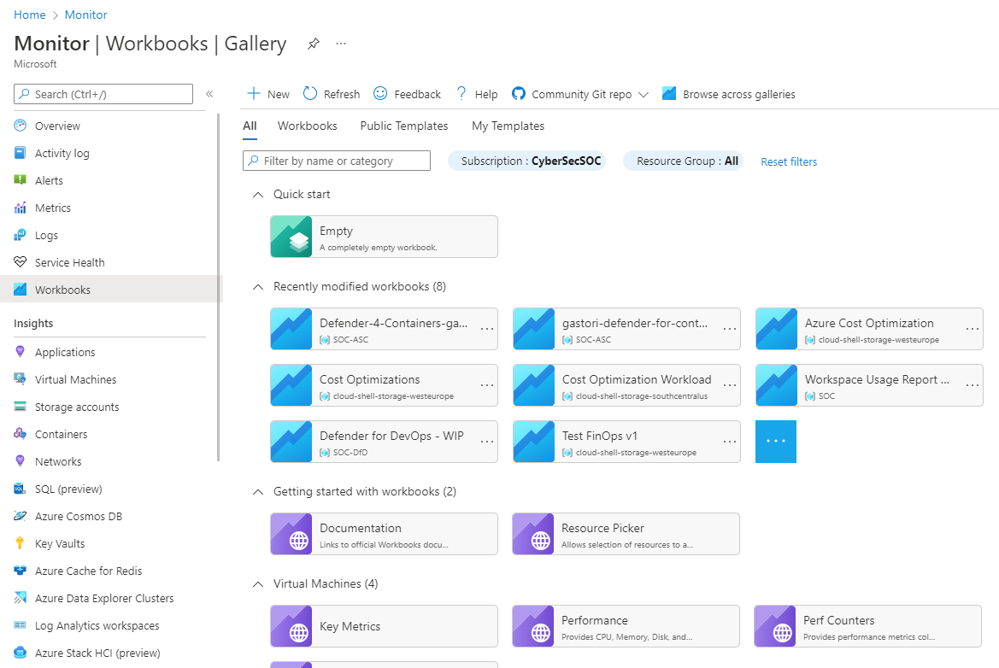
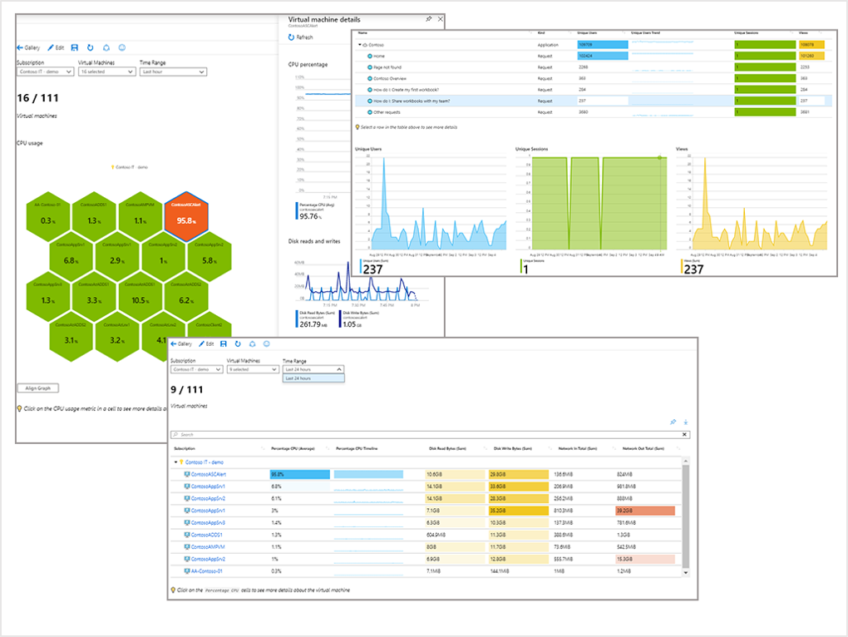
Workbooks
4.2
Notes:
https://learn.microsoft.com/en-us/azure/azure-monitor/overview#visualize
https://learn.microsoft.com/en-us/azure/azure-monitor/visualize/workbooks-overview
Workbooks: Workbooks provide a flexible canvas for data analysis and the creation of rich visual reports in the Azure portal. You can use them to query data from multiple data sources. Workbooks can combine and correlate data from multiple data sets in one visualization giving you easy visual representation of your system. Workbooks are interactive and can be shared across teams with data updating in real time. Use workbooks provided with Insights, utilize the library of templates, or create your own.
Workbooks combine text, log queries, metrics, and parameters into rich interactive reports.
Workbooks are helpful for scenarios such as:
Exploring the usage of your virtual machine when you don't know the metrics of interest in advance. You can discover metrics for CPU utilization, disk space, memory, and network dependencies.
Explaining to your team how a recently provisioned VM is performing. You can show metrics for key counters and other log events.
Sharing the results of a resizing experiment of your VM with other members of your team. You can explain the goals for the experiment with text. Then you can show each usage metric and the analytics queries used to evaluate the experiment, along with clear call-outs for whether each metric was above or below target.
Reporting the impact of an outage on the usage of your VM. You can combine data, text explanation, and a discussion of next steps to prevent outages in the future.
The gallery: The gallery lists all the saved workbooks and templates for your workspace. You can easily organize, sort, and manage workbooks of all types.
All: Shows the top four items for workbooks, public templates, and my templates. Workbooks are sorted by modified date, so you'll see the most recent eight modified workbooks.
Workbooks: Shows the list of all the available workbooks that you created or are shared with you.
Public Templates: Shows the list of all the available ready to use, get started functional workbook templates published by Microsoft. Grouped by category.
My Templates: Shows the list of all the available deployed workbook templates that you created or are shared with you. Grouped by category.
Data sources: Workbooks can query data from multiple Azure sources. You can transform this data to provide insights into the availability, performance, usage, and overall health of the underlying components. For example, you can:
Analyze performance logs from virtual machines to identify high CPU or low memory instances and display the results as a grid in an interactive report.
Combine data from several different sources within a single report. You can create composite resource views or joins across resources to gain richer data and insights that would otherwise be impossible.
Sources: Logs, Metrics, Azure Resource Graph, Azure Resource Manager, Azure Data Explorer, JSON, Merge, Custom endpoint, Workload health, Azure resource health, Azure RBAC, Change Analysis, Prometheus
Visualizations: Workbooks provide a rich set of capabilities for visualizing your data. Each data source and result set support visualizations that are most useful for that data. For more information about the visualizations, see Workbook visualizations. Workbooks support these kinds of visual components:
Text parameters
Using queries:
Charts
Grids
Tiles
Trees
Honeycomb
Graphs
Maps
Text visualization
Access control: Users must have the appropriate permissions to view or edit a workbook. Workbook permissions are based on the permissions the user has for the resources included in the workbooks.

Slide 41
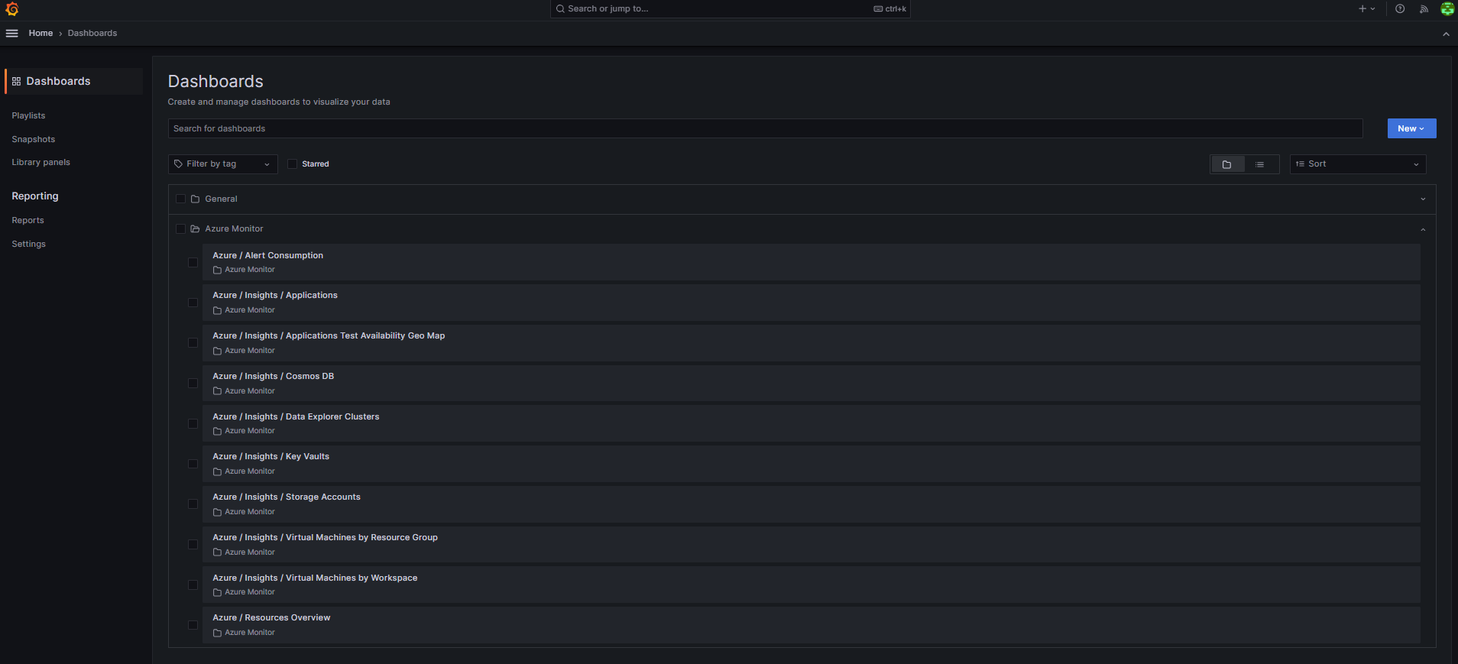
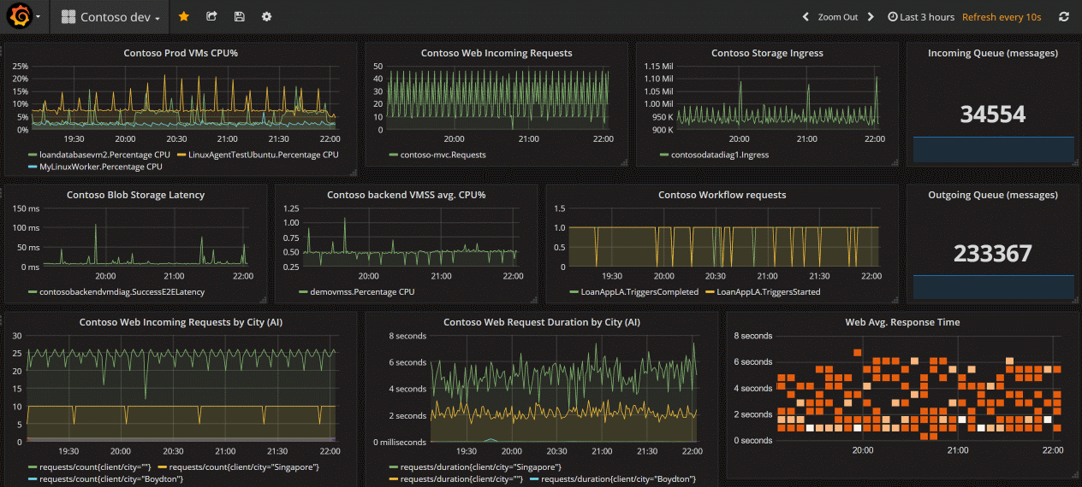
Grafana
4.2
Notes:
https://learn.microsoft.com/en-us/azure/azure-monitor/overview#visualize
https://learn.microsoft.com/en-us/azure/azure-monitor/visualize/grafana-plugin
https://review.learn.microsoft.com/en-us/asm-demo-script/script/azureresources/monitoring/cloud-management-azure-resources-monitoring-azure-managed-grafana?branch=main
Grafana is an open platform that excels in operational dashboards. All versions of Grafana include the Azure Monitor data source plug-in to visualize your Azure Monitor metrics and logs.
Azure Managed Grafana also optimizes this experience for Azure-native data stores such as Azure Monitor and Azure Data Explorer. In this way, you can easily connect to any resource in your subscription and view all resulting monitoring data in a familiar Grafana dashboard. It also supports pinning charts from Azure Monitor metrics and logs to Grafana dashboards. Grafana has popular plug-ins and dashboard templates for non-Microsoft APM tools such as Dynatrace, New Relic, and AppDynamics as well. You can use these resources to visualize Azure platform data alongside other metrics from higher in the stack collected by these other tools. It also has AWS CloudWatch and GCP BigQuery plug-ins for multicloud monitoring in a single pane of glass.
How is Grafana different from other Azure visualization options?
Operational focus
Annotations combine time-series and event/alert data in single panel
Playlists cycle through multiple dashboards
High density visualizations and dashboards
Rich set of visualizations, visualization options and client-side data transformation
Combine visualizations from Azure and non-Azure data sources
Plugins available for OSS – e.g., Jaeger, Zipkin, Standalone Prometheus…
Plugins available for 3rd party tools – App Dynamics, DataDog, New Relic…
Portability and multi-tenancy
Provides ability to export and import dashboards into other instances running in other locations
View data from multiple Azure tenants in a single dashboard – including Lighthouse managed tenants
The plug-in retrieves data from these Azure services:
Azure Monitor Metrics for numeric time series data from Azure resources.
Azure Monitor Logs for log and performance data from Azure resources that enables you to query by using the powerful Kusto Query Language (KQL). You can use Application Insights log queries to retrieve Application Insights log based metrics
Application Insights log based metrics to let you analyze the health of your monitored apps. You can use Application Insights log queries in Grafana to use the Application Insights log metrics data.
Azure Resource Graph to quickly query and identify Azure resources across subscriptions.
You can then display this performance and availability data on your Grafana dashboard.
Use out-of-the-box dashboards:
Azure Monitor contains out-of-the-box dashboards to use with Azure Managed Grafana and the Azure Monitor plugin.
Azure Monitor also supports out-of-the-box dashboards for seamless integration with Azure Monitor managed service for Prometheus. These dashboards are automatically deployed to Azure Managed Grafana when linked to Azure Monitor managed service for Prometheus.
Pin charts from the Azure portal to Azure Managed Grafana:
In addition to building your panels in Grafana, you can also quickly pin Azure Monitor visualizations from the Azure portal to new or existing Grafana dashboards by adding panels to your Grafana dashboard directly from Azure Monitor. Go to Metrics for your resource. Create a chart and select Save to dashboard, followed by Pin to Grafana. Choose the workspace and dashboard and select Pin to complete the operation.

Slide 42
Demo Visualize with: Workbooks & Azure Managed Grafana
Notes:
https://learn.microsoft.com/en-us/azure/azure-monitor/visualize/grafana-plugin
https://review.learn.microsoft.com/en-us/asm-demo-script/script/azureresources/monitoring/cloud-management-azure-resources-monitoring-azure-managed-grafana?branch=main
Follow the documentation and demo script for Azure Managed Grafana.

Slide 43
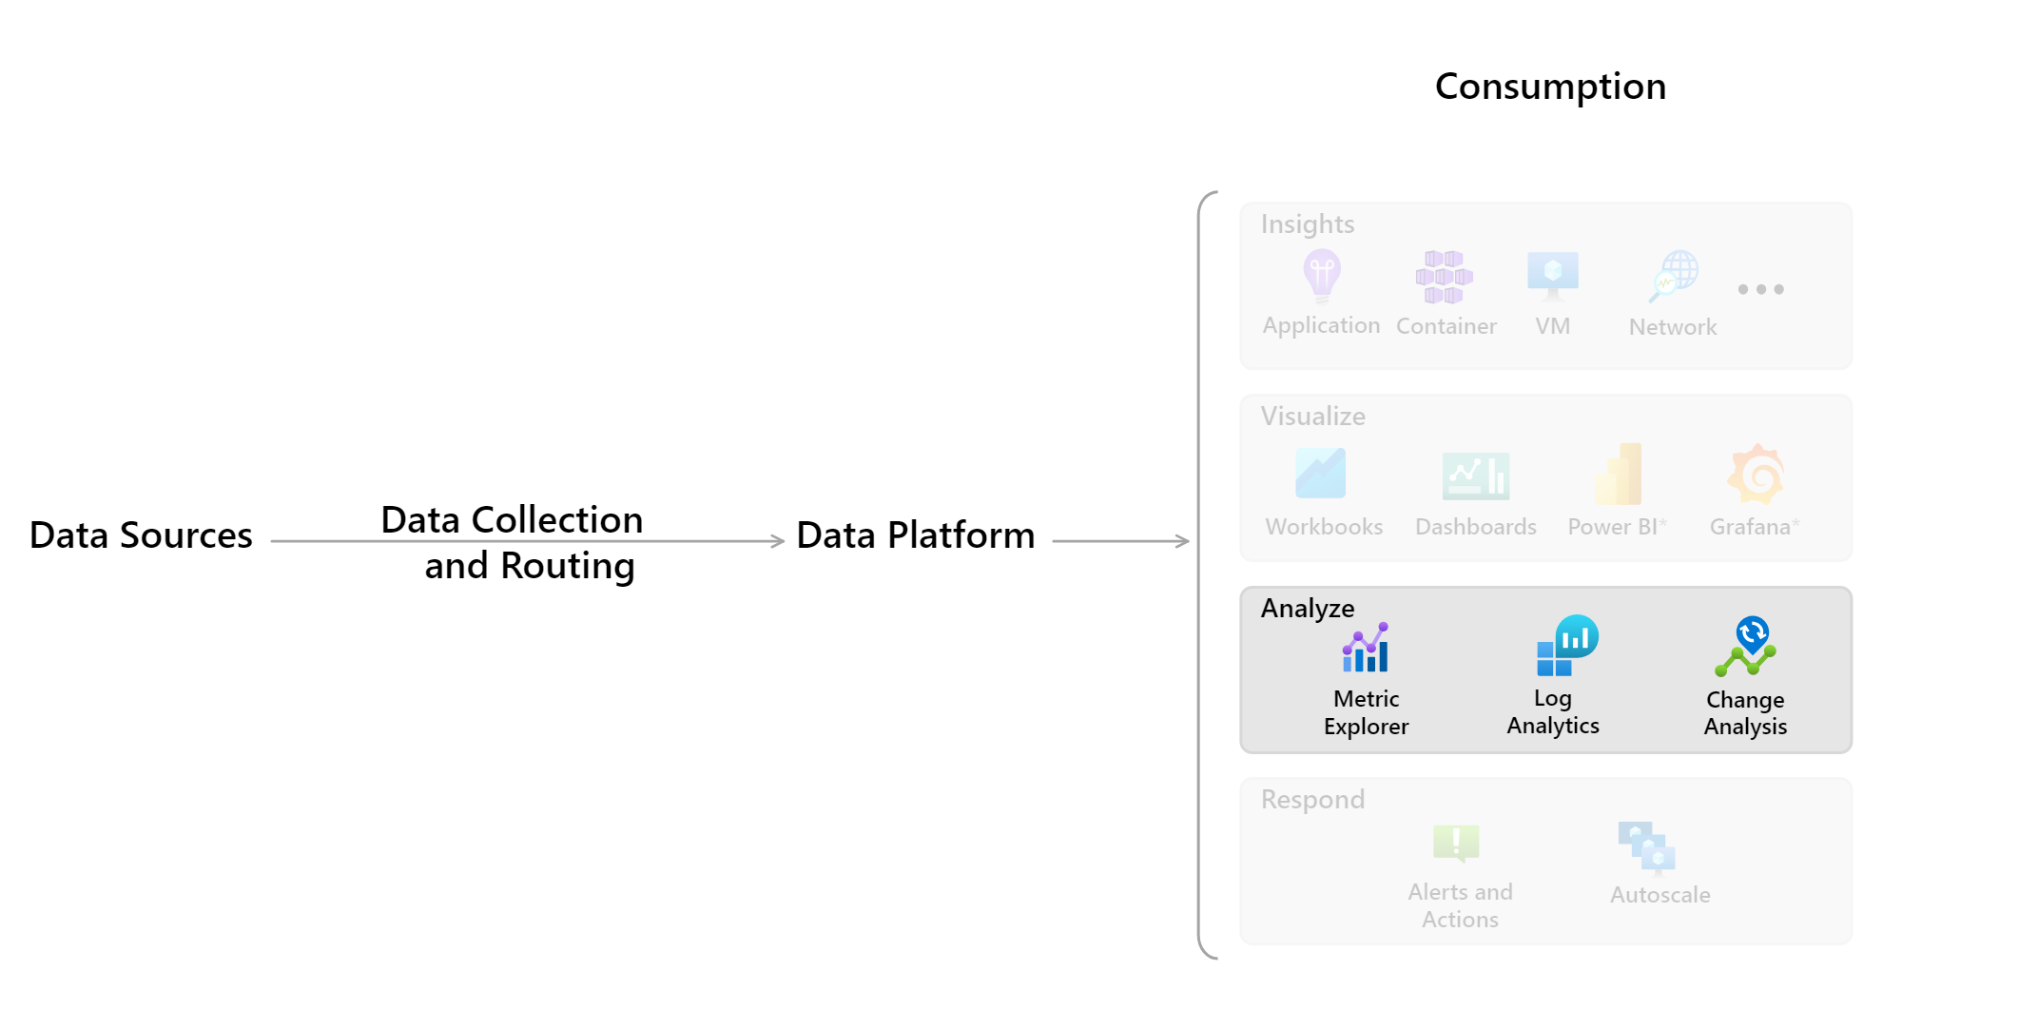
Analyze
4.3
Notes:
https://learn.microsoft.com/en-us/azure/azure-monitor/overview#analyze
The Azure portal contains built in tools that allow you to analyze monitoring data.
Metrics explorer: Use the Azure Monitor metrics explorer user interface in the Azure portal to investigate the health and utilization of your resources. Metrics explorer helps you plot charts, visually correlate trends, and investigate spikes and dips in metric values. Metrics explorer contains features for applying dimensions and filtering, and for customizing charts. These features help you analyze exactly the data you need in a visually intuitive way.
Log Analytics: The Log Analytics user interface in the Azure portal helps you query the log data collected by Azure Monitor so that you can quickly retrieve, consolidate, and analyze collected data. After creating test queries, you can then directly analyze the data with Azure Monitor tools, or you can save the queries for use with visualizations or alert rules. Log Analytics workspaces are based on Azure Data Explorer, using a powerful analysis engine and the rich Kusto query language (KQL).Azure Monitor Logs uses a version of the Kusto Query Language suitable for simple log queries, and advanced functionality such as aggregations, joins, and smart analytics. You can get started with KQL quickly and easily. NOTE: The term "Log Analytics" is sometimes used to mean both the Azure Monitor Logs data platform store and the UI that accesses that store. Previous to 2019, the term "Log Analytics" did refer to both. It's still common to find content using that framing in various blogs and documentation on the internet.
Change Analysis: Change Analysis is a subscription-level Azure resource provider that checks resource changes in the subscription and provides data for diagnostic tools to help users understand what changes might have caused issues. The Change Analysis user interface in the Azure portal gives you insight into the cause of live site issues, outages, or component failures. Change Analysis uses the Azure Resource Graph to detect various types of changes, from the infrastructure layer through application deployment.

Slide 44
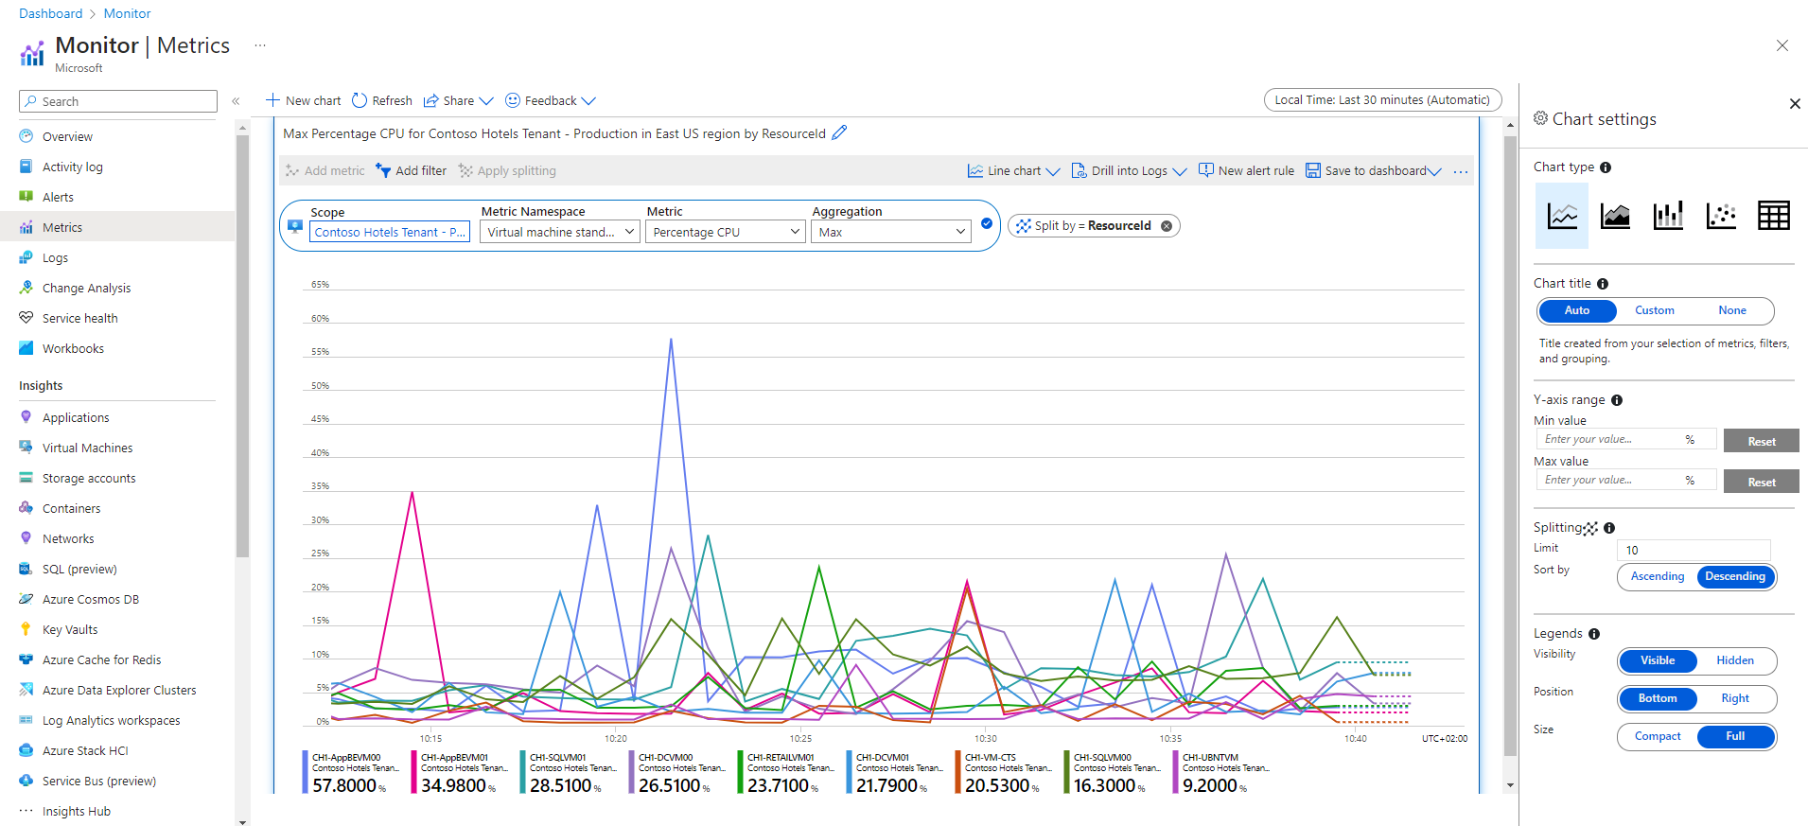
Metrics Explorer
4.3
Resource scope picker
Multiple metric lines and charts
Time range controls
Aggregation
Filters
Metric splitting
Locking the range of the y-axis
Line colors
Saving to dashboards or workbooks
Alert rules
Correlating metrics to logs
Notes:
https://learn.microsoft.com/en-us/azure/azure-monitor/overview#analyze
https://learn.microsoft.com/en-us/azure/azure-monitor/essentials/metrics-getting-started
Azure Monitor metrics explorer is a component of the Azure portal that you can use to plot charts, visually correlate trends, and investigate spikes and dips in metrics' values. Use metrics explorer to investigate the health and utilization of your resources.
Advanced features of Metrics Explorer in Azure Monitor:
Resource scope picker: Use the resource scope picker to view metrics across single resources and multiple resources.
Multiple metric lines and charts: In Metrics Explorer, you can create charts that plot multiple metric lines or show multiple metric charts at the same time. This functionality allows you to:
Correlate related metrics on the same graph to see how one value relates to another.
Display metrics that use different units of measure in close proximity.
Visually aggregate and compare metrics from multiple resources.
For example, imagine that you have five storage accounts, and you want to know how much space they consume together. You can create a stacked area chart that shows the individual values and the sum of all the values at points in time.
Time range controls: In addition to changing the time range by using the time picker panel, you can pan and zoom by using the controls in the chart area.
Aggregation: When you add a metric to a chart, Metrics Explorer applies a default aggregation. The default makes sense in basic scenarios, but you can use a different aggregation to gain more insights about the metric.
Before you use different aggregations on a chart, you should understand how Metrics Explorer handles them. Metrics are a series of measurements (or "metric values") that are captured over a time period. When you plot a chart, the values of the selected metric are separately aggregated over the time granularity.
You select the size of the time grain by using the time picker panel in Metrics Explorer. If you don't explicitly select the time grain, Metrics Explorer uses the currently selected time range by default. After Metrics Explorer determines the time grain, the metric values that it captures during each time grain are aggregated on the chart, one data point per time grain.
Metrics Explorer has five aggregation types:
Sum: The sum of all values captured during the aggregation interval. The sum aggregation is sometimes called the total aggregation.
Count: The number of measurements captured during the aggregation interval. When the metric is always captured with the value of 1, the count aggregation is equal to the sum aggregation. This scenario is common when the metric tracks the count of distinct events and each measurement represents one event. The code emits a metric record every time a new request arrives.
Average: The average of the metric values captured during the aggregation interval.
Min: The smallest value captured during the aggregation interval.
Max: The largest value captured during the aggregation interval.
Filters: You can apply filters to charts whose metrics have dimensions. For example, imagine a Transaction count metric that has a Response type dimension. This dimension indicates whether the response from transactions succeeded or failed. If you filter on this dimension, Metrics Explorer displays a chart line for only successful or only failed transactions.
Metric splitting: You can split a metric by dimension to visualize how different segments of the metric compare. Splitting can also help you identify the outlying segments of a dimension.
Locking the range of the y-axis: Locking the range of the value (y) axis becomes important in charts that show small fluctuations of large values.
For example, a drop in the volume of successful requests from 99.99 percent to 99.5 percent might represent a significant reduction in the quality of service. Noticing a small fluctuation in a numeric value would be difficult or even impossible if you're using the default chart settings. In this case, you could lock the lowest boundary of the chart to 99 percent to make a small drop more apparent.
Another example is a fluctuation in the available memory. In this scenario, the value technically never reaches 0. Fixing the range to a higher value might make drops in available memory easier to spot.
Line colors: Chart lines are automatically assigned a color from a default palette. To change the color of a chart line, select the colored bar in the legend that corresponds to the line on the chart. Use the color picker to select the line color. Customized colors are preserved when you pin the chart to a dashboard.
Saving to dashboards or workbooks: After you configure a chart, you can add it to a dashboard or workbook. By adding a chart to a dashboard or workbook, you can make it accessible to your team. You can also gain insights by viewing it in the context of other monitoring information.
Alert rules: You can use your visualization criteria to create a metric-based alert rule. The new alert rule includes your chart's target resource, metric, splitting, and filter dimensions. You can modify these settings by using the Create an alert rule pane.
Correlating metrics to logs: In Metrics Explorer, Drill into Logs helps you diagnose the root cause of anomalies in your metric chart. Drilling into logs allows you to correlate spikes in your metric chart to the following types of logs and queries:
Activity log: Provides insight into the operations on each Azure resource in the subscription from the outside (the management plane), in addition to updates on Azure Service Health events. Use the activity log to determine the what, who, and when for any write operations (PUT, POST, or DELETE) taken on the resources in your subscription. There's a single activity log for each Azure subscription.
Diagnostic log: Provides insight into operations that you performed within an Azure resource (the data plane). Examples include getting a secret from a key vault or making a request to a database. The content of resource logs varies by the Azure service and resource type. You must enable logs for the resource.
Recommended log: Provides scenario-based queries that you can use to investigate anomalies in Metrics Explorer.

Slide 45
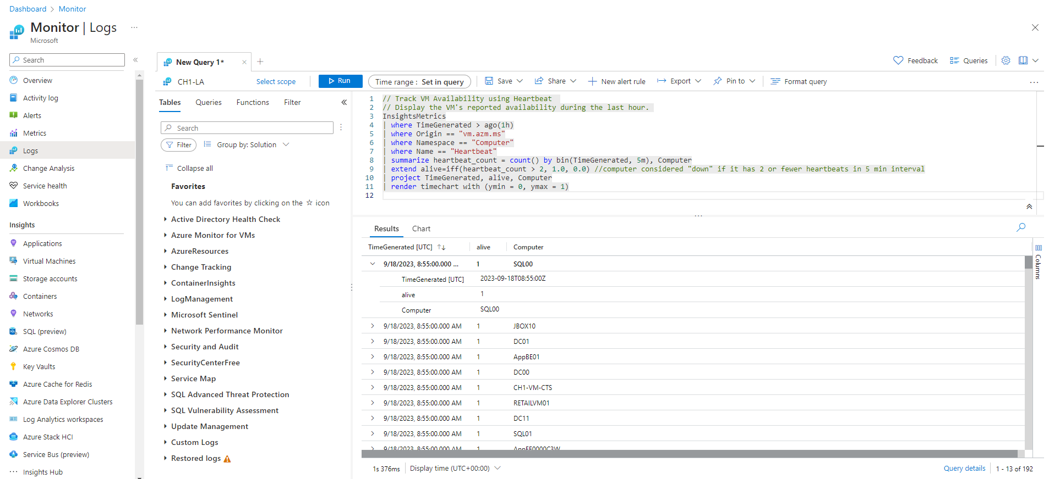
Log Analytics
4.3
1
1
3
2
4
Notes:
https://learn.microsoft.com/en-us/azure/azure-monitor/overview#analyze
https://learn.microsoft.com/en-us/azure/azure-monitor/logs/log-analytics-overview
https://review.learn.microsoft.com/en-us/asm-demo-script/script/azureresources/monitoring/cloud-management-azure-resources-monitoring-log-anaytics?branch=main
Log Analytics is a tool in the Azure portal that's used to edit and run log queries against data in the Azure Monitor Logs store.
You might write a simple query that returns a set of records and then use features of Log Analytics to sort, filter, and analyze them. Or you might write a more advanced query to perform statistical analysis and visualize the results in a chart to identify a particular trend.
Whether you work with the results of your queries interactively or use them with other Azure Monitor features, such as log query alerts or workbooks, Log Analytics is the tool that you'll use to write and test them.
When you start Log Analytics, a dialog appears that contains example queries. The queries are categorized by solution. Browse or search for queries that match your requirements. You might find one that does exactly what you need. You can also load one to the editor and modify it as required. Browsing through example queries is a good way to learn how to write your own queries.
Relationship to Azure Data Explorer: If you've worked with the Azure Data Explorer web UI, Log Analytics should look familiar. That's because it's built on top of Azure Data Explorer and uses the same Kusto Query Language. Log Analytics adds features specific to Azure Monitor, such as filtering by time range and the ability to create an alert rule from a query. Both tools include an explorer that lets you scan through the structure of available tables. The Azure Data Explorer web UI primarily works with tables in Azure Data Explorer databases. Log Analytics works with tables in a Log Analytics workspace.
1. Top action bar: The top bar has controls for working with a query in the query window.
Scope: Specifies the scope of data used for the query. This could be all the data in a Log Analytics workspace or data for a particular resource across multiple workspaces. See Query scope.
Run button: Run the selected query in the query window. You can also select Shift+Enter to run a query.
Time picker: Select the time range for the data available to the query. This action is overridden if you include a time filter in the query. See Log query scope and time range in Azure Monitor Log Analytics.
Save button: Save the query to Query Explorer for the workspace.
Copy button: Copy a link to the query, the query text, or the query results to the clipboard.
New alert rule button: Create a new tab with an empty query.
Export button: Export the results of the query to a CSV file or the query to Power Query Formula Language format for use with Power BI.
Pin to button: Pin the results of the query to an Azure dashboard or add them to an Azure workbook.
Format query button: Arrange the selected text for readability.
Example queries button: Open the example queries dialog that appears when you first open Log Analytics.
Query Explorer button: Open Query Explorer, which provides access to saved queries in the workspace.
2. Left sidebar: The sidebar on the left lists tables in the workspace, sample queries, and filter options for the current query.
Tables: Lists the tables that are part of the selected scope. Select Group by to change the grouping of the tables. Hover over a table name to display a dialog with a description of the table and options to view its documentation and preview its data. Expand a table to view its columns. Double-click a table or column name to add it to the query.
Queries: List of example queries that you can open in the query window. This list is the same one that appears when you open Log Analytics. Select Group by to change the grouping of the queries. Double-click a query to add it to the query window or hover over it for other options.
Filter: Creates filter options based on the results of a query. After you run a query, columns appear with different values from the results. Select one or more values, and then select Apply & Run to add a where command to the query and run it again.
3. The query window: This is where you edit your query.
IntelliSense is used for KQL commands and color coding enhances readability. Select + at the top of the window to open another tab.
A single window can include multiple queries. A query can't include any blank lines, so you can separate multiple queries in a window with one or more blank lines. The current query is the one with the cursor positioned anywhere in it.
To run the current query, select the Run button or select Shift+Enter.
Azure Monitor Logs is based on Azure Data Explorer, and log queries are written by using the same Kusto Query Language (KQL). This rich language is designed to be easy to read and author, so you should be able to start writing queries with some basic guidance.
Areas in Azure Monitor where you'll use queries include:
Log Analytics: Use this primary tool in the Azure portal to edit log queries and interactively analyze their results. Even if you intend to use a log query elsewhere in Azure Monitor, you'll typically write and test it in Log Analytics before you copy it to its final location.
Log alert rules: Proactively identify issues from data in your workspace. Each alert rule is based on a log query that's automatically run at regular intervals. The results are inspected to determine if an alert should be created.
Workbooks: Include the results of log queries by using different visualizations in interactive visual reports in the Azure portal.
Azure dashboards: Pin the results of any query into an Azure dashboard, which allows you to visualize log and metric data together and optionally share with other Azure users.
Azure Logic Apps: Use the results of a log query in an automated workflow by using a logic app workflow.
PowerShell: Use the results of a log query in a PowerShell script from a command line or an Azure Automation runbook that uses Invoke-AzOperationalInsightsQuery.
Azure Monitor Logs API: Retrieve log data from the workspace from any REST API client. The API request includes a query that's run against Azure Monitor to determine the data to retrieve.
Azure Monitor Query client libraries: Retrieve log data from the workspace via an idiomatic client library for the following ecosystems: .NET, Go, Java, JavaScript, Python
4. Results window: The results of a query appear in the results window. By default, the results are displayed as a table. To display the results as a chart, select Chart in the results window. You can also add a render command to your query.
Results view: The results view displays query results in a table organized by columns and rows. Click to the left of a row to expand its values. Select the Columns dropdown to change the list of columns. Sort the results by selecting a column name. Filter the results by selecting the funnel next to a column name. Clear the filters and reset the sorting by running the query again. Select Group columns to display the grouping bar above the query results. Group the results by any column by dragging it to the bar. Create nested groups in the results by adding more columns.
Chart view: The chaVisualization type Type of chart to display.
X-axis: Column in the results to use for the x-axis.
Y-axis: Column in the results to use for the y-axis. Typically, this is a numeric column.
Split by: Column in the results that defines the series in the chart. A series is created for each value in the column.
Aggregation: Type of aggregation to perform on the numeric values in the y-axis.rt view displays the results as one of multiple available chart types. You can specify the chart type in a render command in your query. You can also select it from the Visualization Type dropdown.

Slide 46
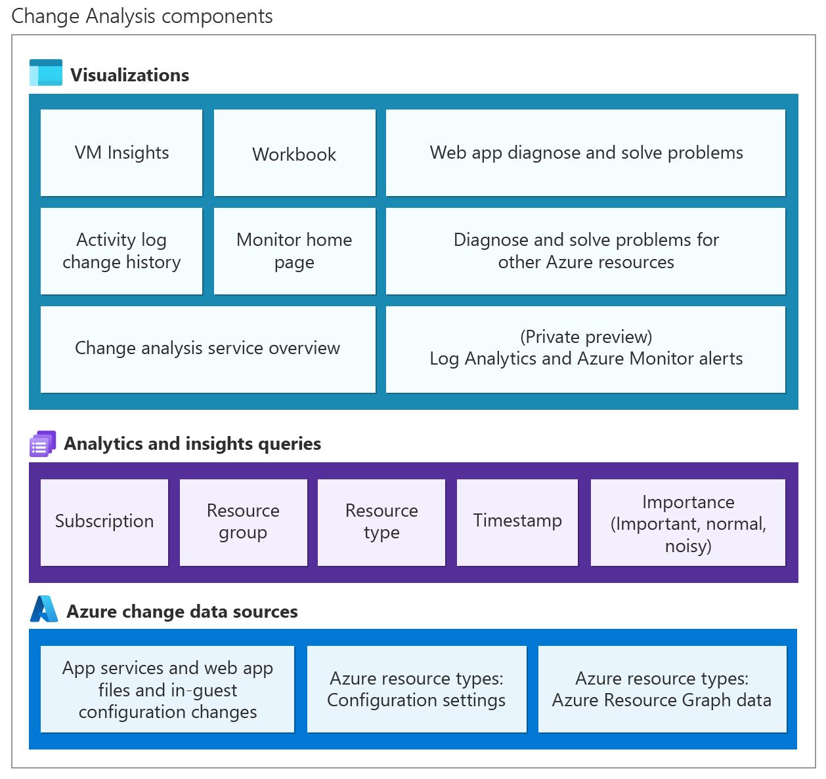
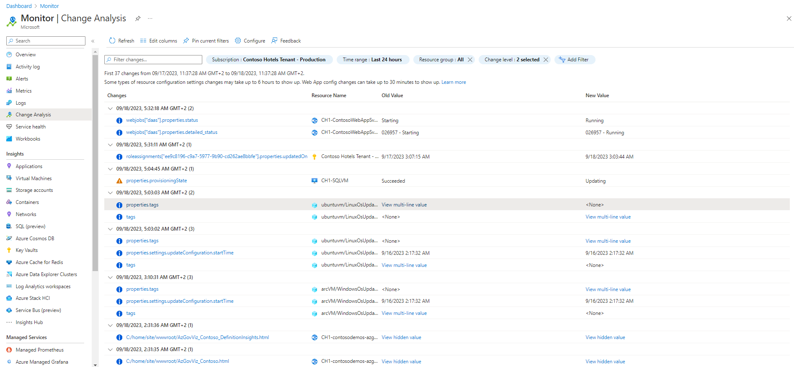
Change Analysis
4.3
Notes:
https://learn.microsoft.com/en-us/azure/azure-monitor/overview#analyze
https://learn.microsoft.com/en-us/azure/azure-monitor/change/change-analysis
While standard monitoring solutions might alert you to a live site issue, outage, or component failure, they often don't explain the cause. For example, your site worked five minutes ago, and now it's broken. What changed in the last five minutes?
We've designed Change Analysis to answer that question in Azure Monitor.
Building on the power of Azure Resource Graph, Change Analysis:
Provides insights into your Azure application changes.
Increases observability.
Reduces mean time to repair (MTTR).
Change Analysis architecture: Change Analysis detects various types of changes, from the infrastructure layer through application deployment. Change Analysis is a subscription-level Azure resource provider that:
Checks resource changes in the subscription.
Provides data for various diagnostic tools to help users understand what changes might have caused issues.

Slide 47
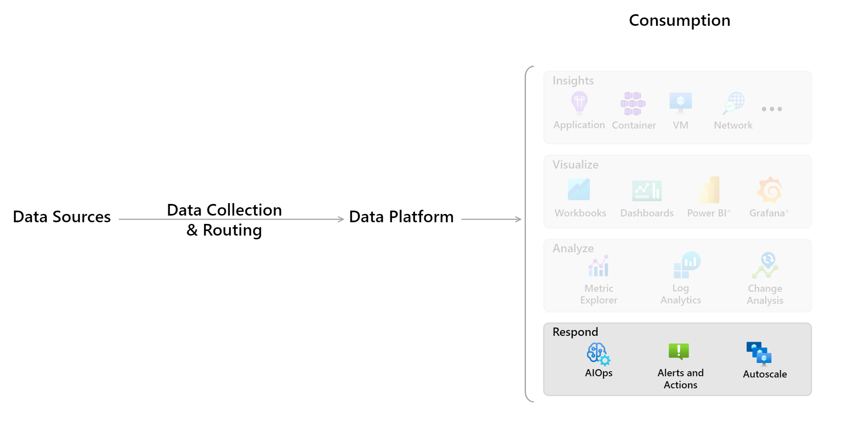
Respond
4.4
Notes:
https://learn.microsoft.com/en-us/azure/azure-monitor/overview#respond
An effective monitoring solution proactively responds to critical events, without the need for an individual or team to notice the issue. The response could be a text or email to an administrator, or an automated process that attempts to correct an error condition.
Artificial Intelligence for IT Operations (AIOps) can improve service quality and reliability by using machine learning to process and automatically act on data you collect from applications, services, and IT resources into Azure Monitor. It automates data-driven tasks, predicts capacity usage, identifies performance issues, and detects anomalies across applications, services, and IT resources. These features simplify IT monitoring and operations without requiring machine learning expertise.
Azure Monitor Alerts notify you of critical conditions and can take corrective action. Alert rules can be based on metric or log data.
Metric alert rules provide near-real-time alerts based on collected metrics.
Log alerts rules based on logs allow for complex logic across data from multiple sources.
Alert rules use action groups, which can perform actions such as sending email or SMS notifications. Action groups can send notifications using webhooks to trigger external processes or to integrate with your IT service management tools. Action groups, actions, and sets of recipients can be shared across multiple rules.
SCOM MI currently uses it's own separate traditional SCOM alerting mechanism in the Ops Console.
Autoscale allows you to dynamically control the number of resources running to handle the load on your application. You can create rules that use Azure Monitor metrics to determine when to automatically add resources when the load increases or remove resources that are sitting idle. You can specify a minimum and maximum number of instances, and the logic for when to increase or decrease resources to save money and to increase performance.
Azure Logic Apps is also an option. For more information, see the Integrate section.

Slide 48
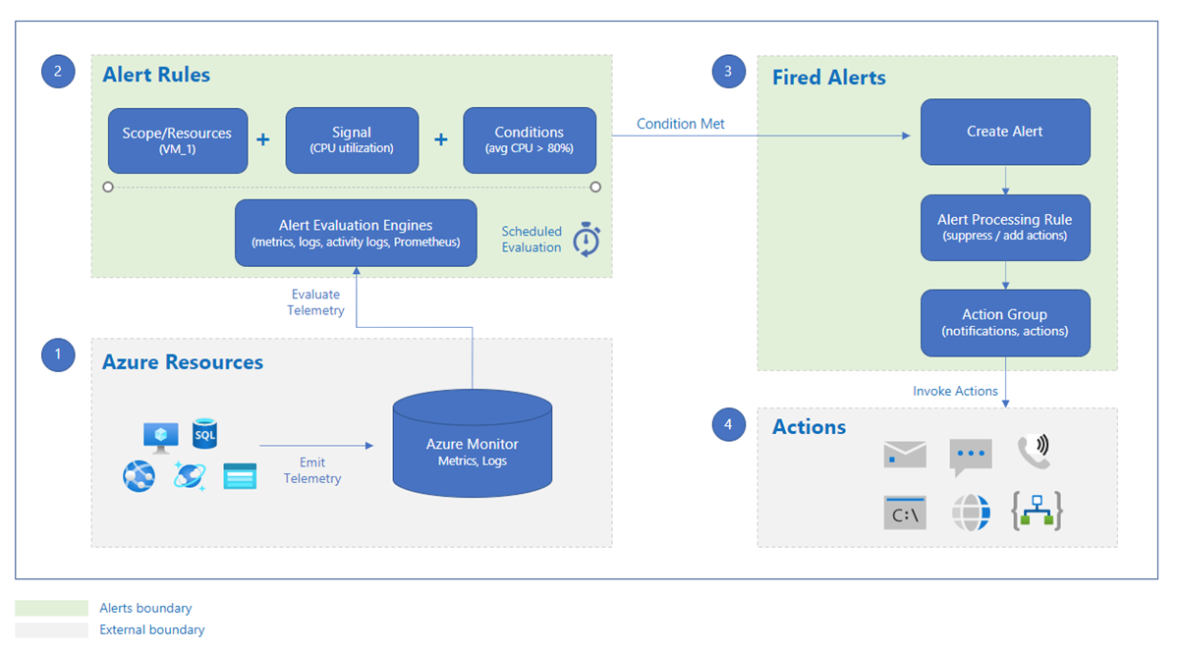
Alerts and actions
4.4
Notes:
https://learn.microsoft.com/en-us/azure/azure-monitor/overview#respond
https://learn.microsoft.com/en-us/azure/azure-monitor/alerts/alerts-overview
https://learn.microsoft.com/en-us/azure/azure-monitor/best-practices-alerts
https://learn.microsoft.com/en-us/azure/azure-monitor/alerts/alerts-create-new-alert-rule
https://learn.microsoft.com/en-us/azure/azure-monitor/alerts/alerts-common-schema
https://learn.microsoft.com/en-us/azure/azure-monitor/alerts/alerts-processing-rules
https://learn.microsoft.com/en-us/azure/azure-monitor/alerts/action-groups
https://learn.microsoft.com/en-us/azure/azure-monitor/alerts/itsmc-overview
Alerts help you detect and address issues before users notice them by proactively notifying you when Azure Monitor data indicates there might be a problem with your infrastructure or application. You can alert on any metric or log data source in the Azure Monitor data platform.
Alert rule:
An alert rule monitors your data and captures a signal that indicates something is happening on the specified resource. The alert rule captures the signal and checks to see if the signal meets the criteria of the condition.
An alert rule combines:
The resources to be monitored.
The signal or data from the resource.
Conditions
An alert is triggered if the conditions of the alert rule are met. The alert initiates the associated action group and updates the state of the alert. If you're monitoring more than one resource, the alert rule condition is evaluated separately for each of the resources, and alerts are fired for each resource separately. Conditions are set by the system. When an alert fires, the alert condition is set to fired. After the underlying condition that caused the alert to fire clears, the alert condition is set to resolved.
Alerts consist of:
Alert processing rules: You can use alert processing rules to make modifications to triggered alerts as they're being fired. You can use alert processing rules to add or suppress action groups, apply filters, or have the rule processed on a predefined schedule.
Action groups: These groups can trigger notifications or an automated workflow to let users know that an alert has been triggered. Action groups can include:
Notification methods, such as email, SMS, and push notifications
Automation runbooks
Azure functions
ITSM incidents: Azure Monitor supports connections with the following ITSM tools: ServiceNow ITSM or IT Operations Management (ITOM) and BMC
Logic apps
Secure webhooks
Webhooks
Event hubs
User response: The response is set by the user and doesn't change until the user changes it.
Types of alerts:
Metric alerts: Metric alerts evaluate resource metrics at regular intervals. Metrics can be platform metrics, custom metrics, logs from Azure Monitor converted to metrics, or Application Insights metrics. Metric alerts can also apply multiple conditions and dynamic thresholds.
Log alerts: Log alerts allow users to use a Log Analytics query to evaluate resource logs at a predefined frequency.
Activity log alerts: Activity log alerts are triggered when a new activity log event occurs that matches defined conditions. Resource Health alerts and Service Health alerts are activity log alerts that report on your service and resource health.
Smart detection alerts: Smart detection on an Application Insights resource automatically warns you of potential performance problems and failure anomalies in your web application. You can migrate smart detection on your Application Insights resource to create alert rules for the different smart detection modules.
Prometheus alerts: Prometheus alerts are used for alerting on Prometheus metrics stored in Azure Monitor managed services for Prometheus. The alert rules are based on the PromQL open-source query language.
Alert state: Alerts can be stateful or stateless
Stateless alerts fire each time the condition is met, even if fired previously.
Stateful alerts fire when the rule conditions are met, and will not fire again or trigger any more actions until the conditions are resolved.
Alerts are stored for 30 days and are deleted after the 30-day retention period.
Common alert schema
Use the common alert schema format to specify the field in the payload, whether or not the action groups configured for the alert rule use the common schema.

Slide 49
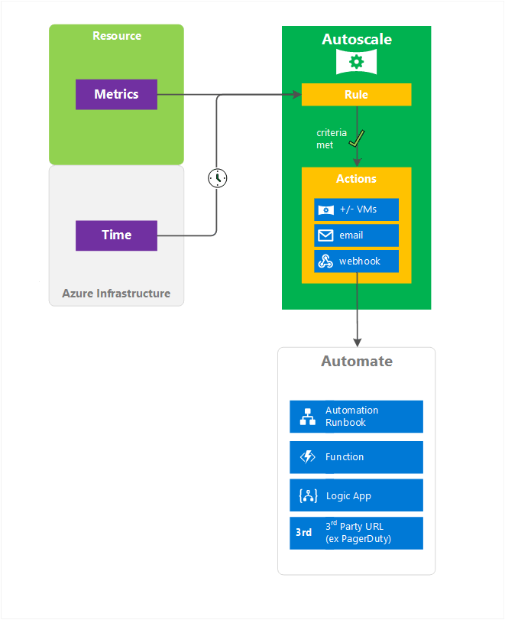
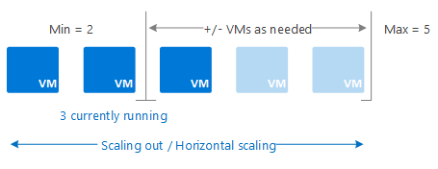
Autoscale
4.4
Notes:
https://learn.microsoft.com/en-us/azure/azure-monitor/overview#respond
https://learn.microsoft.com/en-us/azure/azure-monitor/autoscale/autoscale-overview
Autoscale supports many resource types:
Azure Virtual Machines Scale Sets
Web Apps feature of Azure App Service
Azure API Management service
Azure Data Explorer clusters
Azure Stream Analytics
Azure SignalR Service
Azure Machine Learning workspace
Azure Spring Apps
Azure Media Services
Azure Service Bus
Azure Logic Apps - Integration service environment (ISE)
What is autoscale?
Autoscale is a service that you can use to automatically add and remove resources according to the load on your application.
When your application experiences higher load, autoscale adds resources to handle the increased load. When load is low, autoscale reduces the number of resources, which lowers your costs. You can scale your application based on metrics like CPU usage, queue length, and available memory. You can also scale based on a schedule. Metrics and schedules are set up in rules. The rules include a minimum level of resources that you need to run your application and a maximum level of resources that won't be exceeded.
For example, scale out your application by adding VMs when the average CPU usage per VM is above 70%. Scale it back by removing VMs when CPU usage drops to 40%.
Autoscale scales in and out, or horizontally. Scaling horizontally is an increase or decrease of the number of resource instances. For example, for a virtual machine scale set, scaling out means adding more virtual machines. Scaling in means removing virtual machines. Horizontal scaling is flexible in a cloud situation because you can use it to run a large number of VMs to handle load.
Predictive autoscale
Predictive autoscale uses machine learning to help manage and scale virtual machine scale sets with cyclical workload patterns. It forecasts the overall CPU load on your virtual machine scale set, based on historical CPU usage patterns. The scale set can then be scaled out in time to meet the predicted demand.

Slide 50
Artificial Intelligence for IT Operations (AIOps)
4.4
Use Azure Monitor's built-in AIOps capabilities
Create your own machine learning pipeline
Log Analytics Workspace Insights
Kusto Query Language (KQL) time series analysis and machine learning functions
Application Map Intelligent view
Smart detection
Dynamic thresholds for metric alerting
Predictive autoscale
Azure AI Metrics Advisor
Query data in Azure Monitor Logs
Export data out of Azure Monitor Logs
Notes:
https://learn.microsoft.com/en-us/azure/azure-monitor/overview#respond
https://learn.microsoft.com/en-us/azure/azure-monitor/logs/aiops-machine-learning
Artificial Intelligence for IT Operations (AIOps) offers powerful ways to improve service quality and reliability by using machine learning to process and automatically act on data you collect from applications, services, and IT resources into Azure Monitor.
Azure Monitor's built-in AIOps capabilities provide insights and automate data-driven tasks, such as predicting capacity usage and autoscaling, identifying and analyzing application performance issues, and detecting anomalous behaviors in virtual machines, containers, and other resources. These features boost your IT monitoring and operations, without requiring machine learning knowledge and further investment.
Azure Monitor also provides tools that let you create your own machine learning pipeline to introduce new analysis and response capabilities and act on data in Azure Monitor Logs.
Built-in Azure Monitor AIOps and machine learning capabilities
Log monitoring:
Log Analytics Workspace Insights: A curated monitoring experience that provides a unified view of your Log Analytics workspaces and uses machine learning to detect ingestion anomalies.
Kusto Query Language (KQL) time series analysis and machine learning functions: Easy-to-use tools for generating time series data, detecting anomalies, forecasting, and performing root cause analysis directly in Azure Monitor Logs without requiring in-depth knowledge of data science and programming languages.
Application performance monitoring:
Application Map Intelligent view: Maps dependencies between services and helps you spot performance bottlenecks or failure hotspots across all components of your distributed application.
Smart detection: Analyzes the telemetry your application sends to Application Insights, alerts on performance problems and failure anomalies, and identifies potential root causes of application performance issues.
Metric alerts:
Dynamic thresholds for metric alerting: Learns metrics patterns, automatically sets alert thresholds based on historical data, and identifies anomalies that might indicate service issues.
Virtual machine scale sets:
Predictive autoscale: Forecasts the overall CPU requirements of a virtual machine scale set, based on historical CPU usage patterns, and automatically scales out to meet these needs.
Create your own machine learning pipeline on data in Azure Monitor Logs
Build your own machine learning pipeline on data in Azure Monitor Logs to introduce new AIOps capabilities and support advanced scenarios, such as:
Hunting for security attacks with more sophisticated models than those by KQL.
Detecting performance issues and troubleshooting errors in a web application.
Creating multi-step flows, running code in each step based on the results of the previous step.
Automating the analysis of Azure Monitor Log data and providing insights into multiple areas, including infrastructure health and customer behavior.
Correlating data in Azure Monitor Logs with data from other sources.
There are two approaches to making data in Azure Monitor Logs available to your machine learning pipeline:
Query data in Azure Monitor Logs - Integrate a notebook with Azure Monitor Logs or run a script or application on log data using libraries like Azure Monitor Query client library or MSTICPY to retrieve data from Azure Monitor Logs in tabular form; for example, into a Pandas DataFrame. The data you query is retrieved to an in-memory object on your server, without exporting the data out of your Log Analytics workspace.
Export data out of Azure Monitor Logs - Export data out of your Log Analytics workspace, usually to a blob storage account, and implement your machine learning pipeline using a machine learning library.
To benefit from the best of both implementation approaches, create a hybrid pipeline. A common hybrid approach is to export data for model training, which involves large volumes of data, and to use the query data in Azure Monitor Logs approach to explore data and score new data to reduce latency and costs.

Slide 51
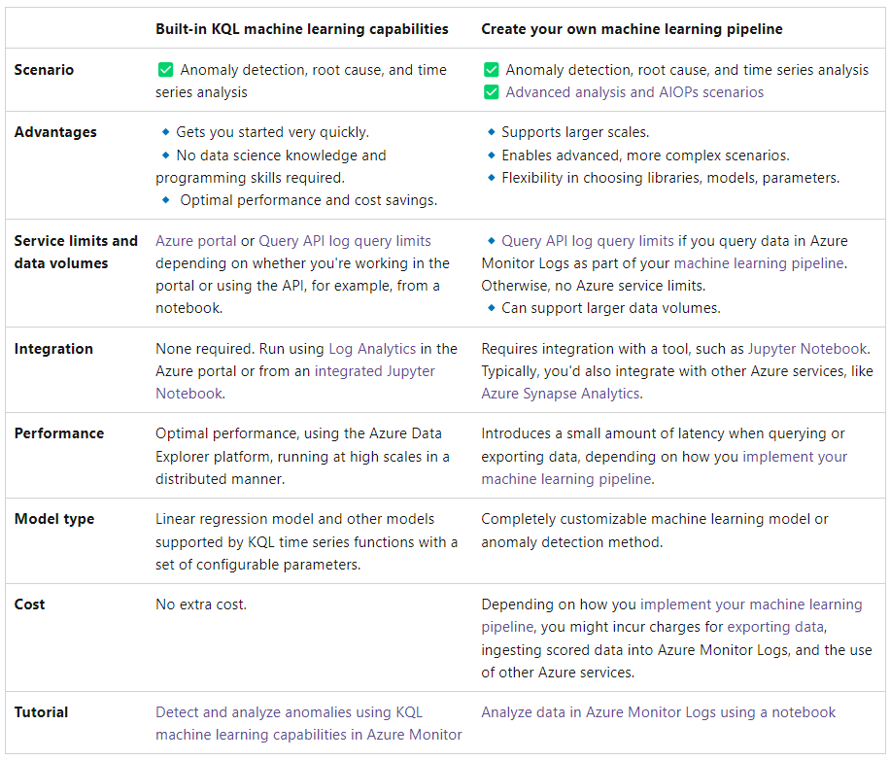
Comparison between built-in and custom capabilities
4.4
Notes:
https://learn.microsoft.com/en-us/azure/azure-monitor/overview#respond
https://learn.microsoft.com/en-us/azure/azure-monitor/logs/aiops-machine-learning
https://learn.microsoft.com/en-us/azure/azure-monitor/logs/aiops-machine-learning#machine-learning-in-azure-monitor-logs
Machine learning in Azure Monitor Logs
Use the Kusto Query Language's built-in time series analysis and machine learning functions, operators, and plug-ins to gain insights about service health, usage, capacity and other trends, and to generate forecasts and detect anomalies in Azure Monitor Logs.
To gain greater flexibility and expand your ability to analyze and act on data, you can also implement your own machine learning pipeline on data in Azure Monitor Logs.
This table compares the advantages and limitations of using KQL's built-in machine learning capabilities and creating your own machine learning pipeline, and links to tutorials that demonstrate how you can implement each.

Slide 52
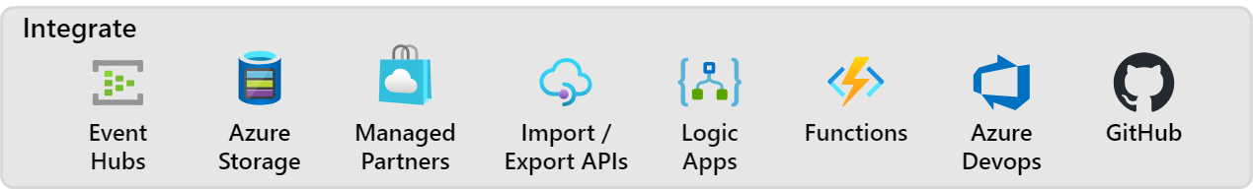
Integrate
5
Notes:
https://learn.microsoft.com/en-us/azure/azure-monitor/overview#integrate
https://learn.microsoft.com/en-us/azure/azure-monitor/agents/agents-overview
https://learn.microsoft.com/en-us/azure/azure-monitor/essentials/stream-monitoring-data-event-hubs
You may need to integrate Azure Monitor with other systems or to build custom solutions that use your monitoring data. These Azure services work with Azure Monitor to provide integration capabilities. Below are only a few of the possible integrations.
Event Hubs: Azure Event Hubs is a streaming platform and event ingestion service. It can transform and store data by using any real-time analytics provider or batching/storage adapters. Use Event Hubs to stream Azure Monitor data to partner SIEM and monitoring tools. Streaming is only available through Diagnostic extension (not AMA yet). Some partners have special integration with Azure Monitor and might be hosted on Azure.
Azure Storage: Export data to Azure storage for less expensive, long-term archival of monitoring data for auditing or compliance purposes. Streaming is only available through Diagnostic extension. (not AMA yet)
Hosted and Managed Partners: Many external partners integrate with Azure Monitor. Azure Monitor has partnered with other monitoring providers to provide an Azure-hosted version of their products to make interoperability easier. Examples include Elastic, Datadog, Logz.io, and Dynatrace.
API: Multiple APIs are available to read and write metrics and logs to and from Azure Monitor in addition to accessing generated alerts. You can also configure and retrieve alerts. With APIs, you have unlimited possibilities to build custom solutions that integrate with Azure Monitor.
Azure Logic Apps: Azure Logic Apps is a service you can use to automate tasks and business processes by using workflows that integrate with different systems and services with little or no code. Activities are available that read and write metrics and logs in Azure Monitor. You can use Logic Apps to customize responses and perform other actions in response to Azure Monitor alerts. You can also perform other more complex actions when the Azure Monitor infrastructure doesn't already supply a built-it method.
Azure Functions: Similar to Azure Logic Apps, Azure Functions give you the ability to pre process and post process monitoring data as well as perform complex action beyond the scope of typical Azure Monitor alerts. Azure Functions uses code however providing additional flexibility over Logic Apps.
Azure DevOps and GitHub: Azure Monitor Application Insights gives you the ability to create Work Item Integration with monitoring data embedding in it. Additional options include release annotations and continuous monitoring.

Slide 53
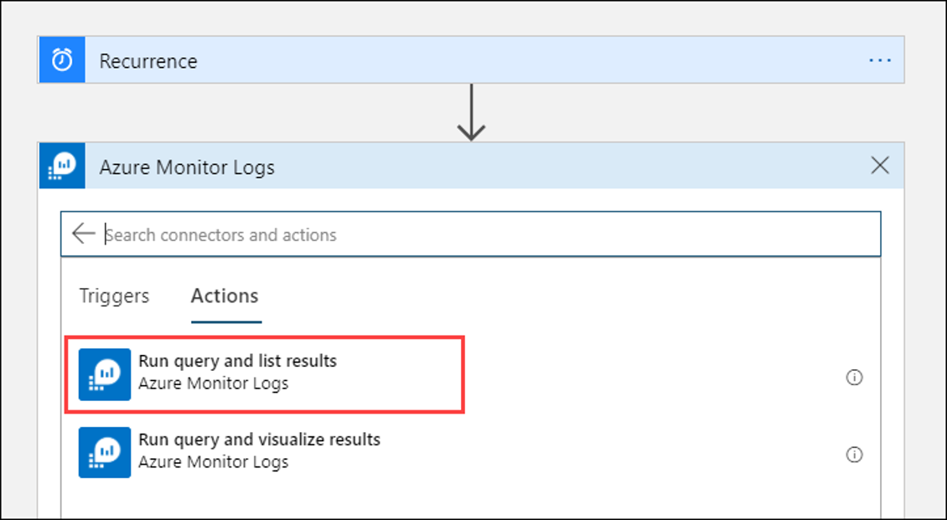
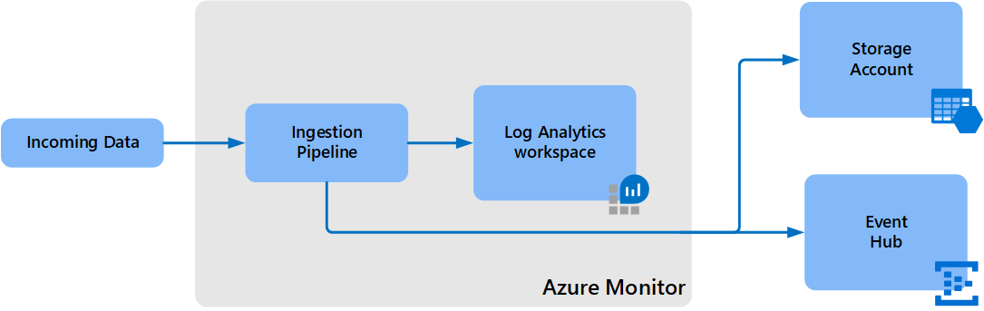
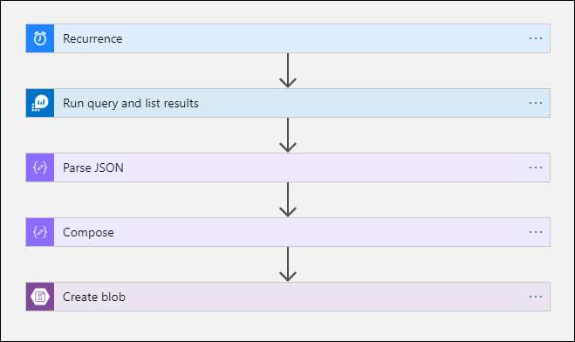
Export data options
5
2. Build with Logic Apps/Azure Function/Azure Data Factory
1. Use native Data Export
Notes:
https://learn.microsoft.com/en-us/azure/azure-monitor/overview#integrate
https://learn.microsoft.com/en-us/azure/azure-monitor/logs/logs-data-export
https://www.powershellgallery.com/packages/Invoke-AzOperationalInsightsQueryExport/1.3
https://learn.microsoft.com/en-us/azure/azure-monitor/logs/logs-export-logic-app
https://learn.microsoft.com/en-us/connectors/azuremonitorlogs/
https://learn.microsoft.com/en-us/azure/connectors/connectors-azure-monitor-logs
https://learn.microsoft.com/en-us/connectors/azuremonitorlogs/
Data Export
Data export in a Log Analytics workspace lets you continuously export data per selected tables in your workspace. You can export to an Azure Storage Account or Azure Event Hubs as the data arrives to an Azure Monitor pipeline. This article provides details on this feature and steps to configure data export in your workspaces.
Data in Log Analytics is available for the retention period defined in your workspace. It's used in various experiences provided in Azure Monitor and Azure services. There are cases where you need to use other tools:
Tamper-protected store compliance: Data can't be altered in Log Analytics after it's ingested, but it can be purged. Export to a Storage Account set with immutability policies to keep data tamper protected.
Integration with Azure services and other tools: Export to Event Hubs as data arrives and is processed in Azure Monitor.
Long-term retention of audit and security data: Export to a Storage Account in the workspace's region. Or you can replicate data to other regions by using any of the Azure Storage redundancy options including GRS and GZRS.
After you've configured data export rules in a Log Analytics workspace, new data for tables in rules is exported from the Azure Monitor pipeline to your Storage Account or Event Hubs as it arrives.
Data is exported without a filter. For example, when you configure a data export rule for a SecurityEvent table, all data sent to the SecurityEvent table is exported starting from the configuration time. Alternatively, you can filter or modify exported data by configuring transformations in your workspace, which apply to incoming data, before it's sent to your Log Analytics workspaces and to export destinations.
Other export options
Log Analytics workspace data export continuously exports data that's sent to your Log Analytics workspace. There are other options to export data for particular scenarios:
Configure diagnostic settings in Azure resources. Logs are sent to a destination directly. This approach has lower latency compared to data export in Log Analytics.
Schedule export of data based on a log query you define with the Log Analytics query API. Use Azure Data Factory, Azure Functions, or Azure Logic Apps to orchestrate queries in your workspace and export data to a destination. This method is similar to the data export feature, but you can use it to export historical data from your workspace by using filters and aggregation. This method is subject to log query limits and isn't intended for scale. For more information, see Export data from a Log Analytics workspace to a Storage Account by using Logic Apps.
One-time export to a local machine by using a PowerShell script. For more information, see Invoke-AzOperationalInsightsQueryExport.

Slide 54









Customize alerts and integrate further actions
5
…. and more!
Notes:
https://learn.microsoft.com/en-us/azure/azure-monitor/overview#integrate
https://learn.microsoft.com/en-us/azure/azure-monitor/logs/logs-export-logic-app
https://learn.microsoft.com/en-us/connectors/azuremonitorlogs/
https://learn.microsoft.com/en-us/azure/connectors/connectors-azure-monitor-logs
https://learn.microsoft.com/en-us/connectors/azuremonitorlogs/
https://learn.microsoft.com/en-us/azure/azure-monitor/alerts/alerts-logic-apps
https://techcommunity.microsoft.com/t5/core-infrastructure-and-security/azure-monitor-alert-notification-via-teams/ba-p/2507676
https://learn.microsoft.com/en-us/connectors/connector-reference/
Customize alert notifications by using Logic Apps
You can use Azure Logic Apps to build and customize workflows for integration. Use Logic Apps to customize your alert notifications. You can:
Customize the alerts email by using your own email subject and body format.
Customize the alert metadata by looking up tags for affected resources or fetching a log query search result. For information on how to access the search result rows that contain alerts data, see:
Azure Monitor Log Analytics API response format
Query/management HTTP response
Integrate with external services by using existing connectors like Outlook, Microsoft Teams, Slack, and PagerDuty. You can also configure the logic app for your own services.

Slide 55


DevOps with GitHub and Azure DevOps
5
Work Item Integration
Pre-built & customizable Keyword Query Language (KQL) queries to add Application Insights data to your work items
Customizable workbook templates
Release annotations with Azure Pipelines build
Continuous monitoring to your release pipeline
Deployment conditions Query Azure Monitor alerts deployment gate
Create audit streaming
Notes:
https://learn.microsoft.com/en-us/azure/azure-monitor/overview#integrate
https://learn.microsoft.com/en-us/azure/azure-monitor/app/work-item-integration
https://learn.microsoft.com/en-us/azure/azure-monitor/app/annotations
https://learn.microsoft.com/en-us/azure/azure-monitor/app/continuous-monitoring
https://learn.microsoft.com/en-us/azure/devops/organizations/audit/auditing-streaming?view=azure-devops
Work Item Integration: Work item integration functionality allows you to easily create work items in GitHub or Azure DevOps that have relevant Application Insights data embedded in them.
Advanced fields like assignee, projects, or milestones.
Repo icons so you can differentiate between GitHub & Azure DevOps workbooks.
Multiple configurations for any number of repositories or work items.
Deployment through Azure Resource Manager templates.
Pre-built & customizable Keyword Query Language (KQL) queries to add Application Insights data to your work items.
Customizable workbook templates.
Release annotations with Azure Pipelines build: Annotations show where you deployed a new build or other significant events. Annotations make it easy to see whether your changes had any effect on your application's performance. They can be automatically created by the Azure Pipelines build system. You can also create annotations to flag any event you want by creating them from PowerShell.
Continuous monitoring to your release pipeline:
Azure Pipelines integrates with Application Insights to allow continuous monitoring of your Azure DevOps release pipeline throughout the software development lifecycle.
With continuous monitoring, release pipelines can incorporate monitoring data from Application Insights and other Azure resources. When the release pipeline detects an Application Insights alert, the pipeline can gate or roll back the deployment until the alert is resolved. If all checks pass, deployments can proceed automatically from test all the way to production, without the need for manual intervention.
Create audit streaming: Audit streams represent a pipeline that flows audit events from your Azure DevOps organization to a stream target. Every half hour or less, new audit events are bundled and streamed to your targets. The following stream targets are available for configuration.
Splunk – Connect to on-premises or cloud-based Splunk.
Azure Monitor Logs - Send auditing logs to Azure Monitor Logs. Logs stored in Azure Monitor Logs can be queried and have alerts configured. Look for the table named AzureDevOpsAuditing. You can also connect Microsoft Sentinel to your workspace.
Azure Event Grid – For scenarios where you want your auditing logs to be sent somewhere else, whether inside or outside of Azure, you can set up an Azure Event Grid connection.

Slide 56




Continuous monitoring and DevOps
Azure Monitor
Native IDE integrations in VS (.NET) and VS Code (Node.js)
Visual Studio IDE
Azure DevOps services
Configure pre- or post- deployment Quality Gates with metrics/alerts
Azure Monitor
Azure Boards
Azure Repos
Azure Artifacts
Azure Pipelines
Azure Test Plans
Run load tests, ping tests, or multi-step web tests for Synthetic Perf Monitoring
File and track bugs/work items with Azure Boards/GitHub
Run code-level analyses in production with Snapshot Debugging and Profiling

Slide 57

Azure Native ISV Services
5
Notes:
https://learn.microsoft.com/en-us/azure/azure-monitor/overview#integrate
https://learn.microsoft.com/en-us/azure/azure-monitor/partners
https://learn.microsoft.com/en-us/azure/partner-solutions/
Many external partners integrate with Azure Monitor.
Azure Monitor has partnered with other monitoring providers to provide an Azure-hosted version of their products to make interoperability easier. Examples include Elastic, Datadog, Logz.io, and Dynatrace.

Slide 58
Multicloud and hybrid monitoring with Azure Monitor
Notes:
If you need to keep your data on-prem or would like to use Azure Monitor for your multicloud workloads, you can do so using Azure Arc.

Slide 59

Azure Arc
7
Notes:
https://learn.microsoft.com/en-us/azure/azure-monitor/best-practices-multicloud
https://learn.microsoft.com/en-us/azure/azure-arc/servers/concept-log-analytics-extension-deployment
https://learn.microsoft.com/en-us/azure/azure-arc/servers/deployment-options
https://learn.microsoft.com/en-us/azure/azure-arc/servers/plan-at-scale-deployment
https://learn.microsoft.com/en-us/azure/azure-monitor/agents/azure-monitor-agent-manage
https://learn.microsoft.com/en-us/azure/azure-monitor/vm/vminsights-enable-overview
https://learn.microsoft.com/en-us/azure/azure-arc/servers/manage-vm-extensions
Purpose of the slide here is to introduce and explain what is Azure Arc.
In addition to monitoring services and application in Azure, Azure Monitor can provide complete monitoring for your resources and applications running on-premises and in other clouds including Amazon Web Services (AWS) and Google Cloud Platform (GCP).
Why Azure Arc:
Complexity: “I need to have health visibility in a single pane of glass to all my existing and future infrastructure and applications.”
Compliance: “I need to manage security and incident management across my public cloud and datacenter assets.”
Regulation: “Our DB layer must remain on-premises due to sensitive patient data and data availability needs.”
Inconsistency: “I want my on-prem skills to work in the cloud, and my cloud skills to work on-prem.”
Latency: “We can’t take a dependency on the internet. If we lose connectivity, we still want to be able to access the data.”
Legacy: “Our older systems take too much maintenance. We want evergreen technology and to pay for it like a utility.”
Virtual machines:
VM insights in Azure Monitor uses Azure Arc-enabled servers to provide a consistent experience between both Azure virtual machines, your VM on-premies, and your AWS EC2 or GCP VM instances. You can view your hybrid machines right alongside your Azure machines and onboard them using identical methods. This includes using standard Azure constructs such as Azure Policy and applying tags.
The Azure Monitor agent installed by VM insights collects telemetry from the client operating system of virtual machines regardless of their location. Use the same data collection rules that define your data collection across all of the virtual machines across your different cloud environments.
Onboarding methods: Connecting machines in your hybrid environment directly with Azure can be accomplished using different methods, depending on your requirements and the tools you prefer to use.
Interactively:
Connect machines using a deployment script
Connect machines from Windows Admin Center
Interactively/At scaoe
Connect machines to Azure Arc with PowerShell
Connect machines to Azure Arc with PowerShell DSC
At scale:
Connect machines using a service principal
Connect machines using Configuration Manager script
Connect machines using Configuration Manager custom task sequence
Connect machines at scale using group policy
Connect machines using Ansible playbooks
Connect machines from Automation Update Management
Deployment of Azure Monitor Agent:
Non-Azure: To install the agent on physical servers and virtual machines hosted outside of Azure (that is, on-premises) or in other clouds, you must install the Azure Arc Connected Machine agent first, at no added cost.
Azure Monitor supports multiple methods to install the Azure Monitor agent and connect your machine or server registered with Azure Arc-enabled servers to the service. Azure Arc-enabled servers support the Azure VM extension framework, which provides post-deployment configuration and automation tasks, enabling you to simplify management of your hybrid machines like you can with Azure VMs.
Installation options: Review the different methods to install the VM extension using one method or a combination and determine which one works best for your scenario.
Use Azure Arc-enabled servers: This method supports managing the installation, management, and removal of VM extensions from the Azure portal, using PowerShell, the Azure CLI, or with an Azure Resource Manager (ARM) template.
Advantages
Can be useful for testing purposes
Useful if you have a few machines to manage
Disadvantages
Limited automation when using an Azure Resource Manager template
Can only focus on a single Arc-enabled server, and not multiple instances
Only supports specifying a single workspace to report to; requires using PowerShell or the Azure CLI to configure the Log Analytics Windows agent VM extension to report to up to four workspaces
Doesn't support deploying the Dependency agent from the portal; you can only use PowerShell, the Azure CLI, or ARM template
Use Azure Policy: You can use Azure Policy to deploy the Azure Monitor agent VM extension at-scale to machines in your environment, and maintain configuration compliance. This is accomplished by using either the Configure Linux Arc-enabled machines to run Azure Monitor Agent or the Configure Windows Arc-enabled machines to run Azure Monitor Agent policy definition. Azure Policy includes several prebuilt definitions related to Azure Monitor.
Advantages
Reinstalls the VM extension if removed (after policy evaluation)
Identifies and installs the VM extension when a new Azure Arc-enabled server is registered with Azure
Disadvantages
The Configure operating system Arc-enabled machines to run Azure Monitor Agent policy only installs the Azure Monitor agent extension and configures the agent to report to a specified Log Analytics workspace.
Standard compliance evaluation cycle is once every 24 hours. An evaluation scan for a subscription or a resource group can be started with Azure CLI, Azure PowerShell, a call to the REST API, or by using the Azure Policy Compliance Scan GitHub Action.
Use Azure Automation: The process automation operating environment in Azure Automation and its support for PowerShell and Python runbooks can help you automate the deployment of the Azure Monitor agent VM extension at scale to machines in your environment.
Advantages
Can use a scripted method to automate its deployment and configuration using scripting languages you're familiar with
Runs on a schedule that you define and control
Authenticate securely to Arc-enabled servers from the Automation account using a managed identity
Disadvantages
Requires an Azure Automation account
Experience authoring and managing runbooks in Azure Automation
Must create a runbook based on PowerShell or Python, depending on the target operating system
Use Azure portal: The Azure Monitor agent VM extension can be installed using the Azure portal. See Automatic extension upgrade for Azure Arc-enabled servers for more information about installing extensions from the Azure portal.
Advantages
Point and click directly from Azure portal
Useful for testing with small set of servers
Immediate deployment of extension
Disadvantages
Not scalable to many servers
Limited automation
Kubernetes
Container insights in Azure Monitor uses Azure Arc-enabled Kubernetes to provide a consistent experience between both Azure Kubernetes Service (AKS) and Kubernetes clusters in your AWS EKS or GCP GKE instances. You can view your hybrid clusters right alongside your Azure machines and onboard them using identical methods. This includes using standard Azure constructs such as Azure Policy and applying tags.
Use Prometheus remote write from your on-premises, AWS, or GCP clusters to send data to Azure managed service for Prometheus.
The Azure Monitor agent installed by Container insights collects telemetry from the client operating system of clusters regardless of their location. Use the same analysis tools on Container insights to monitor clusters across your different cloud environments.
Applications
Applications hosted outside of Azure must be hard coded to send telemetry to Azure Monitor Application Insights using SDKs for supported languages. Annual code maintenance should be planned to upgrade the SDKs per Application Insights SDK support guidance.
If you use Grafana for visualization of monitoring data across your different clouds. use the Azure Monitor data source to include application log and metric data in your dashboards.
If you use Data Dog, use Azure integrations to include application log and metric data in your Data Dog UI.
-----------
What is Azure Arc:
- Today, companies struggle to control and govern increasingly complex environments that extend across data centers, multiple clouds, and edge. Each environment and cloud possesses its own set of management tools, and new DevOps and ITOps operational models can be hard to implement across resources. Azure Arc simplifies governance and management by delivering a consistent multicloud and on-premises management platform.
- Azure Arc provides a centralized, unified way to:
Manage your entire environment together by projecting your existing non-Azure and/or on-premises resources into Azure Resource Manager.
Manage virtual machines, Kubernetes clusters, and databases as if they are running in Azure.
Use familiar Azure services and management capabilities, regardless of where your resources live.
Continue using traditional ITOps while introducing DevOps practices to support new cloud native patterns in your environment.
Configure custom locations as an abstraction layer on top of Azure Arc-enabled Kubernetes clusters and cluster extensions.
- Azure Arc-enabled infrastructure resources:
Azure Arc-enabled servers: Manage Windows and Linux physical servers and virtual machines hosted outside of Azure.
Azure Arc-enabled SQL Server: Extend Azure services to SQL Server instances hosted outside of Azure.
Azure Arc-enabled Kubernetes: Attach and configure Kubernetes clusters running anywhere, with multiple supported distributions.
Azure Arc-enabled VMware vSphere: Provision, resize, delete and manage virtual machines based on VMware vSphere and enable VM self-service through role-based access.
Azure Arc-enabled VMs on Azure Stack HCI: Provision, resize, delete and manage virtual machines based on Azure Stack HCI and enable VM self-service through role-based access. (Azure Arc VM management)
Azure Arc-enabled System Center Virtual Machine Manager: Azure Arc-enabled System Center Virtual Machine Manager (SCVMM) empowers System Center customers to connect their VMM environment to Azure and perform VM self-service operations from Azure portal. With Azure Arc-enabled SCVMM, you get a consistent management experience across Azure.
- Azure Arc-enabled services resources: With Azure Arc-enabled Kubernetes, you can deploy Azure services that allow you to take advantage of specific hardware, comply with data residency requirements, or enable new scenarios. Examples of services include:
Azure Arc-enabled data services: Run Azure data services on-premises, at the edge, and in public clouds using Kubernetes and the infrastructure of your choice. SQL Managed Instance and PostgreSQL services are currently available.
Azure Arc-enabled Machine Learning: You can easily enable an Azure Arc-enabled Kubernetes (Arc Kubernetes) cluster to become a Kubernetes compute target in Azure Machine Learning, and use it to train or deploy models.
Event Grid on Kubernetes
App Services on Azure Arc: You can run App Service, Functions, and Logic Apps on an Azure Arc-enabled Kubernetes cluster.
API Management: You can deploy the API Management gateway on an Azure Arc-enabled Kubernetes cluster and expand API Management support for hybrid and multicloud environments.
Azure Arc-enabled Open Service Mesh

Slide 60















Arc-enabled Infrastructure Consistent governance, security, and visibility for your hybrid and multi-cloud compute.
7
Microsoft Defender
Azure
Monitor
Microsoft Sentinel
Azure
Policy
Update Management
Inventory Management
Azure Automanage
Azure Services across your infrastructure
On - premises
Notes:
Purpose of the slide here is to list Azure Arc-enabled infrastructure integration with Azure Services, and especially with Azure Monitor.
Highlight that Azure Monitor have support for Arc-enabled Servers and Arc-enabled Kubernetes clusters.

Slide 61

Azure Connected Machine agent
7
Notes:
https://learn.microsoft.com/en-us/azure/azure-arc/servers/prerequisites
https://learn.microsoft.com/en-us/azure/azure-arc/servers/network-requirements
https://learn.microsoft.com/en-us/azure/azure-arc/servers/agent-overview
https://learn.microsoft.com/en-us/azure/azure-arc/servers/manage-agent?tabs=windows#update-or-remove-proxy-settings
https://learn.microsoft.com/en-us/azure/azure-arc/servers/private-link-security
Generally, connectivity requirements include these principles:
All connections are TCP unless otherwise specified.
All HTTP connections use HTTPS and SSL/TLS with officially signed and verifiable certificates.
All connections are outbound unless otherwise specified.
To use a proxy, verify that the agents and the machine performing the onboarding process meet the network requirements in this article.
Azure Arc-enabled server endpoints are required for all server based Arc offerings.
Networking configuration:
The Azure Connected Machine agent for Linux and Windows communicates outbound securely to Azure Arc over TCP port 443. By default, the agent uses the default route to the internet to reach Azure services. You can optionally configure the agent to use a proxy server if your network requires it. Proxy servers don't make the Connected Machine agent more secure because the traffic is already encrypted.
To further secure your network connectivity to Azure Arc, instead of using public networks and proxy servers, you can implement an Azure Arc Private Link Scope .
If outbound connectivity is restricted by your firewall or proxy server, make sure the URLs and Service Tags listed below are not blocked.

Slide 62









Azure Arc-enabled servers Connectivity Options
7
Direct connection (Internet)
Connection via Proxy (Internet)
Private Link (S2S VPN/ER)
Azure Arc Service Endpoint
Public Endpoint
Private Endpoint
3
Internet
Azure Arc enabled Server
Service tag
Private Link
Proxy
Azure Express Route &
Site-to-Site VPN
Azure VNET
Notes:
https://learn.microsoft.com/en-us/azure/cloud-adoption-framework/scenarios/hybrid/arc-enabled-servers/eslz-arc-servers-connectivity
https://learn.microsoft.com/en-us/azure/azure-arc/servers/network-requirements?tabs=azure-cloud
https://learn.microsoft.com/en-us/azure/azure-arc/data/connectivity
https://github.com/adstuart/azure-arc-esu
Direct connection: Azure Arc-enabled servers offer a direct connectivity to Azure public endpoints. With this connectivity method, all machine agents will open a connection via the internet using a public endpoint. The connected machine agent for Linux and Windows communicates outbound to Azure in a secure manner using the HTTPS protocol (TCP/443). When using the direct connection method, you need to review your internet access for the connected machine agent. We recommend configuring the required network rules.
Proxy server or firewall connection: If the machine uses a firewall or a proxy server to communicate over the internet, the agent connects outbound using the HTTP protocol. If outbound connectivity is restricted by your firewall or a proxy server, make sure to allow the IP ranges as per the Connected Machine agent network requirements. When you only allow the required IP ranges or domain names for the agent to communicate with the service, use service tags and URLs to configure your firewall or proxy server. If you deploy extensions on your Azure Arc-enabled servers, every extension has its own endpoint, and you must also allow all corresponding URLs in the firewall or proxy. Adding these endpoints will ensure granular secured network traffic to meet principle of least privilege (PoLP).
Private Link: Azure Arc-enabled servers let you deploy VM extensions to centrally manage your servers from Azure. These extensions connect to other resources such as Log Analytics workspaces, automation accounts, Key Vault or Azure Storage. You can use Azure Private Link to make this connection private without opening any public network access. All of the data is kept private, preventing data exfiltration. The traffic between Azure Arc-enabled servers and Azure services will go through a Site-to-Site VPN tunnel or an ExpressRoute with private peering.

Slide 63

Azure Connected Machine agent connectivity
7
Notes:
https://learn.microsoft.com/en-us/azure/azure-arc/servers/prerequisites
https://learn.microsoft.com/en-us/azure/azure-arc/servers/network-requirements
https://learn.microsoft.com/en-us/azure/azure-arc/servers/agent-overview
https://learn.microsoft.com/en-us/azure/azure-arc/servers/manage-agent?tabs=windows#update-or-remove-proxy-settings
https://learn.microsoft.com/en-us/azure/azure-arc/servers/private-link-security
Generally, connectivity requirements include these principles:
All connections are TCP unless otherwise specified.
All HTTP connections use HTTPS and SSL/TLS with officially signed and verifiable certificates.
All connections are outbound unless otherwise specified.
To use a proxy, verify that the agents and the machine performing the onboarding process meet the network requirements in this article.
Azure Arc-enabled server endpoints are required for all server based Arc offerings.
Networking configuration:
The Azure Connected Machine agent for Linux and Windows communicates outbound securely to Azure Arc over TCP port 443. By default, the agent uses the default route to the internet to reach Azure services. You can optionally configure the agent to use a proxy server if your network requires it. Proxy servers don't make the Connected Machine agent more secure because the traffic is already encrypted.
To further secure your network connectivity to Azure Arc, instead of using public networks and proxy servers, you can implement an Azure Arc Private Link Scope .
If outbound connectivity is restricted by your firewall or proxy server, make sure the URLs and Service Tags listed below are not blocked.

Slide 64





























Azure partners with several monitoring and analytics solutions
*and many more…growing as we speak!

Slide 65

Resources
Azure Monitor updates
http://aka.ms/AzMonUpdates
Documentation
http://aka.ms/AzMonDocs
Learning Path
http://aka.ms/AzMonLearn
Best Practices Cookbooks
http://aka.ms/AzMonBestPracticesGuide
http://aka.ms/VMCookbook
http://aka.ms/AKSCookbook

Slide 66
Questions and next steps
Notes:
Tailor the discussion depending on questions that were not addressed and the next steps.

Slide 67
Thank you!

